Slide 1
SENTIMENT ANALYSIS OF CHINA’S “ONE-BELT ONE-ROAD” INITIATIVE AND ITS EFFECTS ON CHINA’S SOFT POWER
Lee Pei May
Goh Hong Lip

Slide 2
Aims
The project intends to:
i) gauge Malaysian public perception about BRI
ii) to interpret the findings using soft power concept
Sentiment analysis is important to understand how people feel about BRI.

Slide 3
Background
"One-Belt One Road" Initiative (OBOR), also known as the "Belt and Road Initiative" (BRI) is a trending topic among Malaysians.
Malaysian government supported the BRI initiative and welcomed Chinese investment.
East Coast Rail Link and Malaysia-China Kuantan Industrial Park were among the BRI projects implemented in Malaysia.
The initial focus of the BRI is to promote economic development but the initiative has been extended to include cultural exchanges.
In a speech during the BRI forum, President Xi emphasised that ‘the economic investments and cultural exchanges as the core of the BRI projects’(Jakimow, 2019, p. 374).

Slide 4
Methodology
Qualitative research - Twitter
Tweets between 1st January 2018 to 1st January 2020
Collected 1860 tweets related to OBOR/BRI
After data cleaning, only 874 tweets remained
The visual presentation of this research analysis result is shown in three methods: wordcloud, a pie chart, time-series graphs

Slide 5
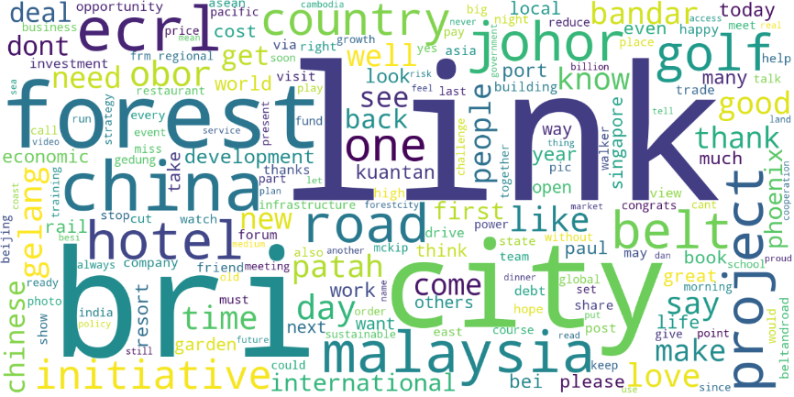
Wordcloud
China BRI
Forest City Johor
Malaysia ECRL Project

Slide 6
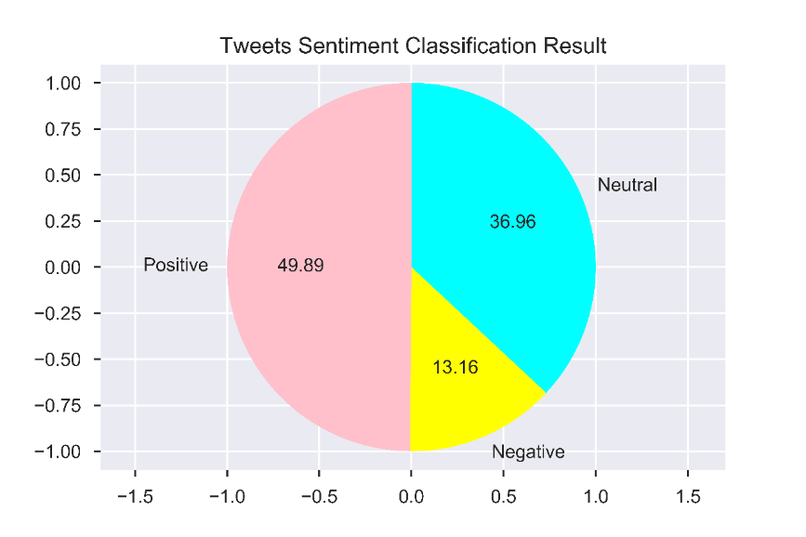
Pie Chart
436 positive
323 Neutral
115 Negative

Slide 7
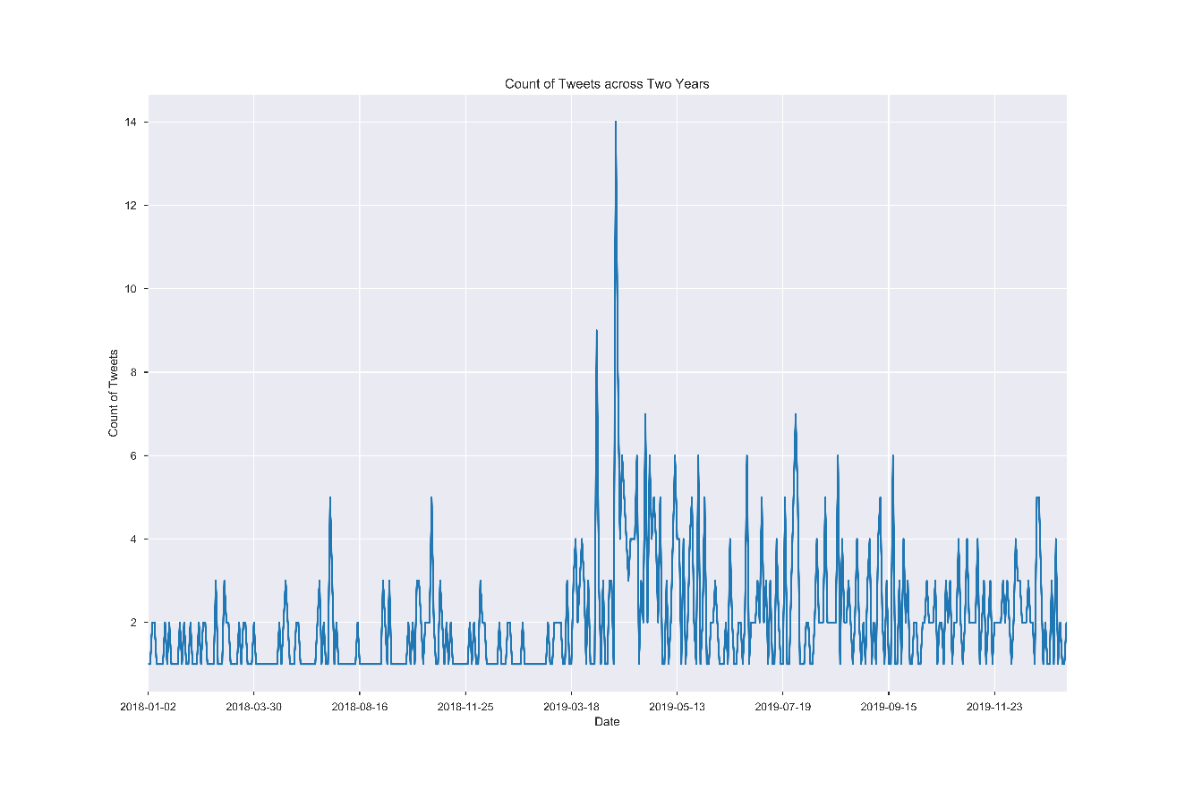
Time series Graph

Slide 8
Concept of Soft Power
Introduced by Joseph Nye
Soft power as ‘second face of power’
The ability to persuade and attract others
Resources of soft power: foreign policy, culture, political values

Slide 9
BRI and China’s Soft Power
Jakimow (2019) study found that desecuritisation narratives produced by China in Central-Eastern European countries have successfully enhanced China’s soft power.
Voon & Xu (2020) study argued otherwise. BRI did not significantly enhance Chinese soft power in BRI countries because it was offset by other concerns.

Slide 10
Discussions
In general, Chinese-led BRI was well-received by Malaysian as majority of the Tweets were positive (49.89%).
From the sentiment analysis, we can see that Malaysian viewed BRI purely as an economic initiative.
President Xi opined that BRI can be used to promote China’s soft power.
However, we don’t find tweets that touch on the cultural aspect of BRI in Malaysia.
Acknowledged that promotion of Chinese values and culture are undertaken separately.

Slide 11
Conclusion
Malaysian viewed BRI positively but there were pushback.
Massive attention on BRI and the scale of the initiative
Showcase the attractiveness of Chinese culture and values, which could increase the legitimacy of its foreign policy and in turn enhance China’s soft power.
Integrated approach to introduce cultural elements in future BRI projects in Malaysia and possibly in existing BRI projects.
To increase positive view of China and acceptance of BRI.

