Slide 1
International Conference on Islamic Studies and Social Sciences (ICONISSS) 2021
Fakultas Ilmu Agama Islam
Universitas Islam Indonesia

Slide 2
Digital Services and Social Stability: Evaluating The Impact from a Maqasidic Approach
Dr. Ramzi Bendebka, Dr. Amar Fettane and Dr. Ibrahim Ahmad Shogar
International Islamic University Malaysia

Slide 3
During the Covid-19 epidemic, there was an urgent need for many countries to move as quickly as possible towards digital services such as e-government, e-learning and e-commerce.
The positive aspects of this transformation cannot be overlooked, however, other negative effects may result from the long and medium-term of such an approach.

Slide 4
Research Questions
what are the effects of the increasing trend towards digital services and how can they affect social stability?
How can these effects be deal with from a Maqasidic approach?

Slide 5
Concepts and Methodology
The term "social stability" refers to the range of life structure and a regular routine that protects against future situational dangers and helps preserve links with social resources and social conditioning (German & Latkin, 2012).
Digital Services are services delivered via the internet or an electronic network, whose nature makes their delivery essentially automated with minimal human intervention and impossible to ensure without the use of information technology (Stephan, 2015).

Slide 6
Methodology: Figure (1) Digital Services and Social Stability Major Issues.
Digital Services
Social Stability
Quality of Information accessibility
Internet Access Equality
Social Trust and Cohesion
Community Engagement

Slide 7
Results 1) Information Accessibility
The Shift to remote practices. in Africa and Latin America, more than 51 % of working people are affected by the labour informality that existed prior to the pandemic (IACHR, 2021).
The limitation of resources. not all students or teachers have access to digital hardware, or the knowledge and working conditions necessary to use and benefit from existing digital platforms (The World Bank, 2021).
Data-sharing systems. access to timely and effective care is currently limited by the lack of harmonisation between different systems. Many extraordinarily valuable data for users' exploration and interactions during the pandemic are not easily available and accessible.

Slide 8
Table. 1 Percentage of Countries Offering Mobile Apps or SMS for Public Information Updates from 2016 to 2020, By Sector
Years | Education | Employment | Health | Environment | Social Protection | Justice
2016 | 30% | 25% | 34% | 24% | 23% | --
2018 | 46% | 38% | 36% | 36% | 33% | --
2020 | 54% | 54% | 54% | 52% | 47% | 41%

Slide 9
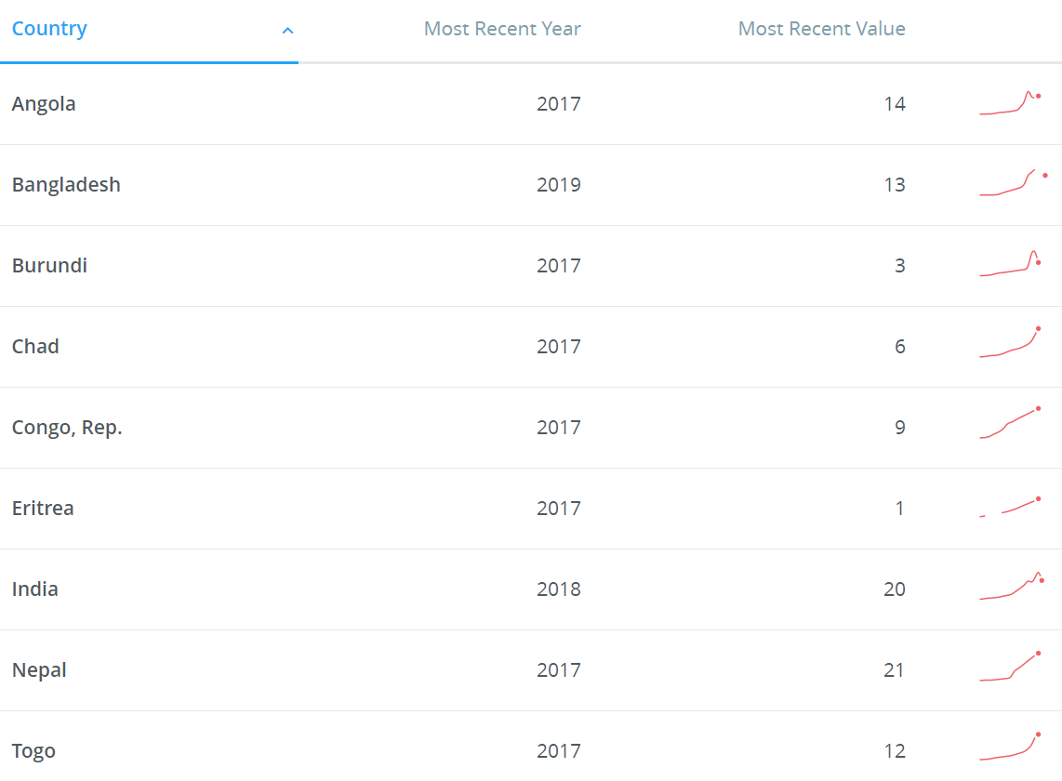
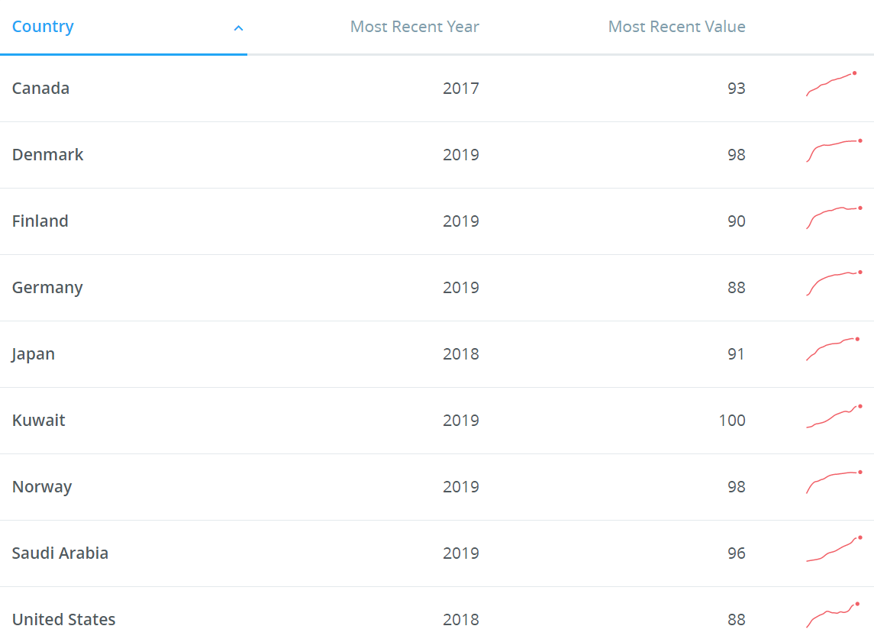
2) Internet Access Equality

Slide 10
3) Social Trust and Cohesion (Digital Services)
From a strategy to promote social distancing.
A means to deal against government policies (Breaking Quarantine).

Slide 11
3) Social Trust and Cohesion
People with high social trust are frequently well-connected and integrated into their social networks (Delhey and Newton, 2003; Newton, 2018), enforcing digital platforms and social distancing measures would impact their daily lives than people with low social trust.
a variety of difficulties have harmed social cohesion in a number of countries. For example, the pandemic occurred at a time when public faith in the government was weak, the economy was damaged by lower revenue income, protests were common across the country.
when it comes to this issue, people in some regions do not trust their governments even in daily life face-to-face practices. However, it became worse when the governments in different countries tried to move to digital services, as people could not trust their government.

Slide 12
4) Community Engagement
Families and individuals become vulnerable to food insecurity, or become homeless because of the COVID-19 pandemic.
considering digital services without taking care of all the above categories can be seen as a sign of discrimination against society. Moreover, it may increase instability as individuals feel more isolated and far from realising their fundamental rights and life commodities.

Slide 13
Discussion: Figure (2) Foundation of Social Stability in Islam (Toward Digital Services).
Digital Services
The Faith and Knowledge
Morals and Actions
Justice and Non-Discrimination
Material Foundation
Obligatory and non-Obligatory Expenses
Protecting the Weak People among Community
Foundations of Social Stability in Islam

Slide 14
Conclusion
E-learning, e-commerce, and e-governance can help people achieve their goals in all aspects of their lives, including fighting disease, improving health, and making life more comfortable. However, on the other hand, digital services can seriously compromise social stability and security, aggravate inequality and discrimination, and reduce human connection and interaction. When it comes to how we use and manage digital services, Islam has a response. From a Maqasidic perspective, the faith and education foundation and the material foundation must be combined in any process to promote digital services. Islam's morality, good actions, and non-discrimination nature can guide individuals, communities, and authorities in achieving any digital process. Moreover, the material foundation was well discussed in Islamic heritage that can serve as a platform instead of developing policies and regulations.

Slide 15
Acknowledgment
This presentation is a part of a project named: Sustaining Social Balance and Peace in the Post-COVID-19 Pandemic: A Study In The Light Of Maqasid Al-Sharia’h Approach. The project was granted by The International Institute of Islamic Thought (IIIT). Hence, researchers would like to express their gratitude to the IIIT for the absolute trust and continued support.

