Slide 1
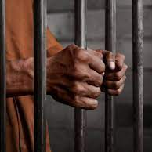
Pengenalan Prosedur Jenayah
Disediakan oleh:
Asst. Prof. Dr Zuraini Ab Hamid
Ahmad Ibrahim Kulliyyah of Laws, IIUM

Slide 2
Kandungan:
Sejarah Kanun Prosedur Jenayah
Struktur Mahkamah
Adjektif dan undang-undang substantif
Undang-undang Sivil dan Jenayah
Beban pembuktian

Slide 3
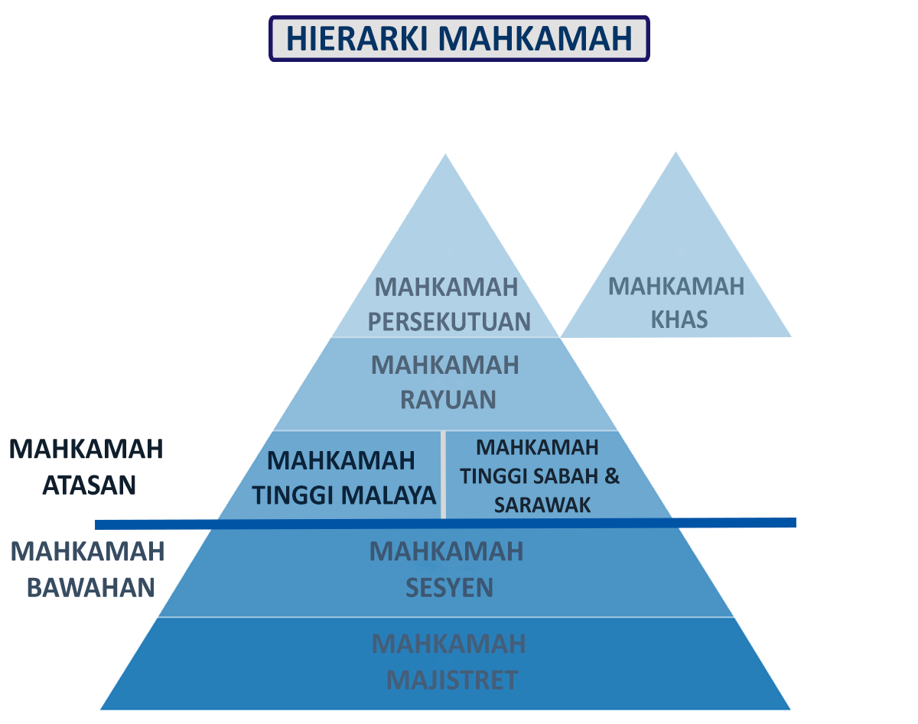
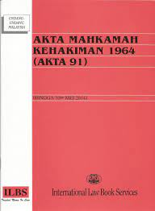
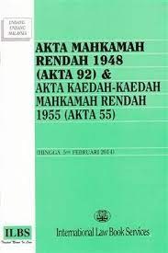
Mahkamah Atasan tertakluk kepada AKTA MAHKAMAH KEHAKIMAN 1964
Mahkamah Bawahan tertakluk kepada AKTA MAHKAMAH RENDAH 1948

Slide 4
BIDANGKUASA kehakiman.gov.my
Jurisdiction of
High Court

Slide 5
UNDANG-UNDANG: SUBSTANTIF ATAU ADJEKTIF?
UNDANG-UNDANG
SUBSTANTIF
ADJEKTIF
SIVIL
JENAYAH
PROSEDURAL
KETERANGAN

Slide 6
Kajian Kes: Imigresen
Kes 1: 3 Nepal
Kes 2: Tiada dokumen sah
Kes 3: PATI

Slide 7
PERBEZAAN UNDANG-UNDANG JENAYAH DAN SIVIL

Slide 8
Beban pembuktian

Slide 9
Peringkat Pendakwaan PRIMA FACIE
Makna Literal
Makna secara undang-undang
sek. 173 (h)(iii) dan sek 180 (4) :
Kes prima facie dihasilkan terhadap tertuduh dimana pihak pendakwaan telah membawa masuk bukti yang boleh dipercayai membuktikan elemen kesalahan tersebut dimana sekiranya tidak dapat dijelaskan akan menyebabkan sabitan keatas tertuduh

Slide 10
Diakhir kes pendakwaan MELAMPAUI KERAGUAN MUNASABAH
Mat v PP [1963] MLJ 263:
“The correct law for magistrates to apply is as follows. If you accept the explanation given by or on behalf of the accused, you must of course acquit. But this does not entitle you to convict if you do not believe that explanation, for he is still entitled to an acquittal if it raises in your mind a reasonable doubt to his guilt, as the onus of proving his guilt lies throughout on the prosecution. If upon the whole evidence you are left in a real state of doubt, the prosecution has failed to satisfy the onus of prove which lies upon it.

Slide 11
SOAL JAWAB

