Slide 1
Poverty and Digital Literacy: A study on Children Living at the Pusat Perumahan Rakyat (PPR)
LEAD RESEARCHER:
Dr. Shafizan Mohamed (IIUM)
RESEARCH MEMBERS:
Professor Saodah Wok (IIUM)
Dr. Wan Norshira Wan Ghazali (IIUM)
Dr. Nur Shakira Mohd. Nasir (IIUM)

Slide 2
Research Problem
Digital Literacy of the B-40
The Malaysian government projected that by 2030, Malaysia will become a developed country.
Communications and Multimedia Blueprint (CMB) 2018-2025
Education Blueprint 2013-2025
Children living at the Pusat Perumahan Rakyat (PPR) is a segment of the B40 that could be left behind by the government’s progressive policies if they are not given the right guidance and worldviews to be a part of a developed Malaysia.
Digital technology is a powerful tool that can facilitate these children into becoming active citizens. These children need to be provided with the right combination of digital access and digital literacy.

Slide 3
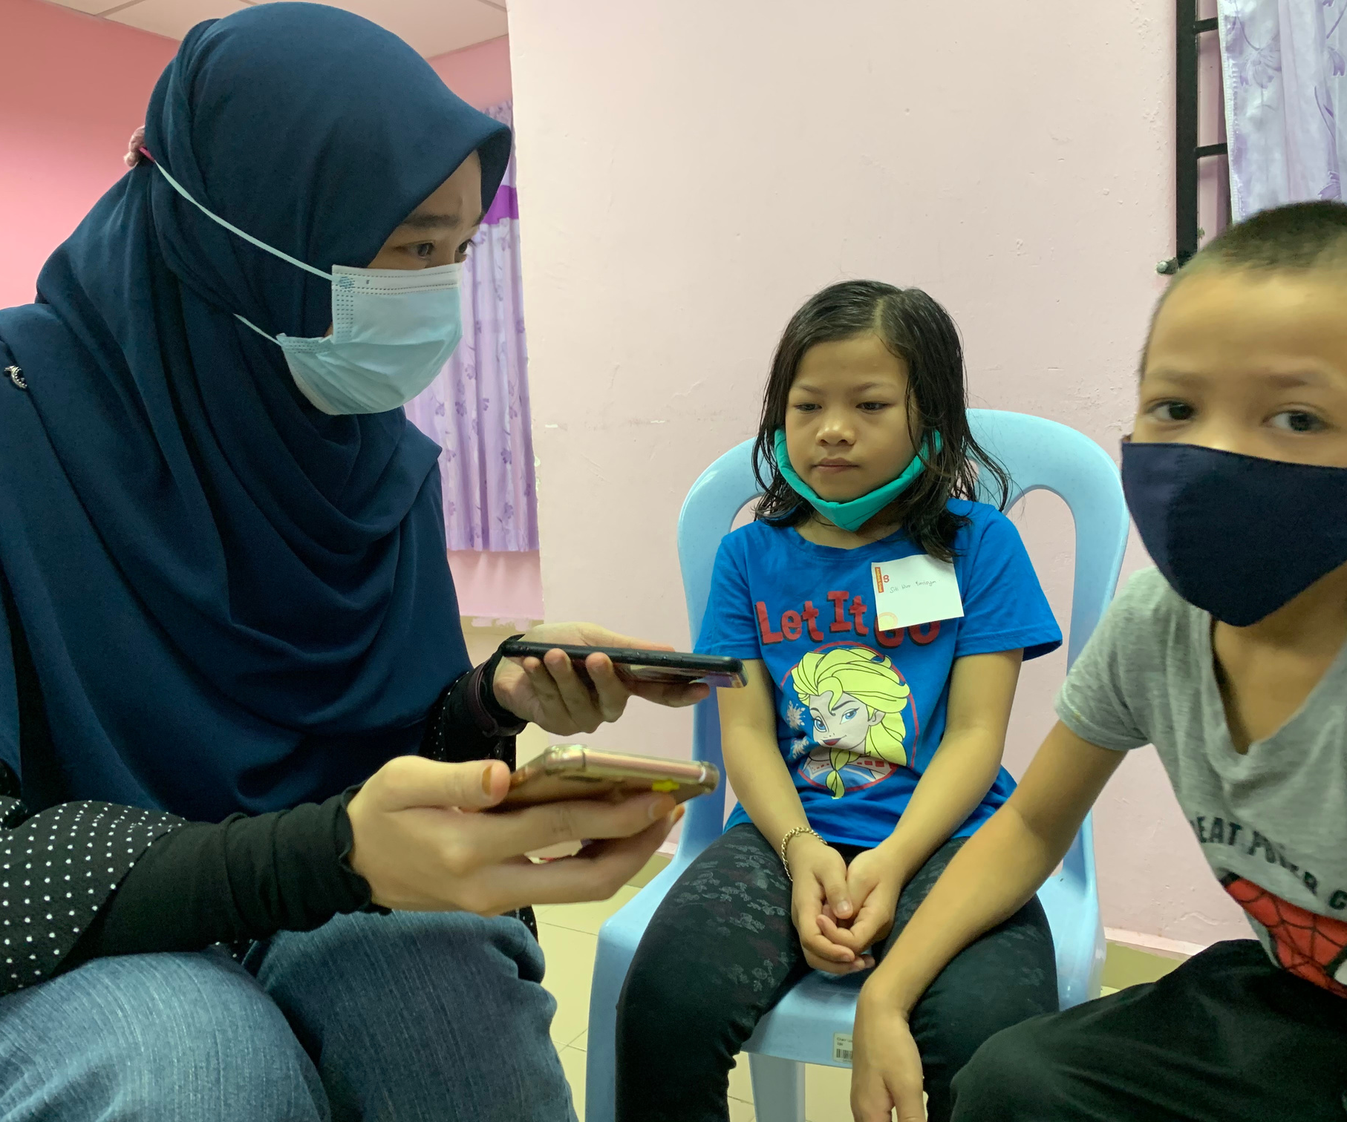
Formulate inclusive initiatives and strategies that will cater to the needs of children who are socioeconomically challenged.
Provide a holistic insight into how digital literacy programs can be prioritized in relevant policy-based and community-based digitization programs.
The research investigated:
level of digital media adoption and use
digital media literacy areas and skills most required (operational, security, participation and content creation)
Research
Objectives

Slide 4
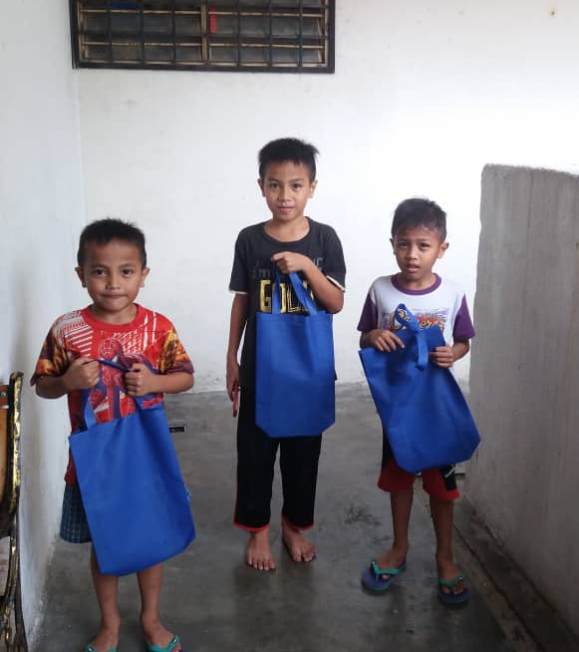
Theoretical Framework:
DigComp Digital Competency
Methodology
308 children living at PPR Desa Rejang, PPR Sungai Bonus and PPR Kota Damansara
Phone Survey
Focus Group Interviews
January - March 2021
Informational and operational skills
2. Safety and security
3. Communication and Participation
4. Content creation and digital innovation
5. Problem-solving skills

Slide 5
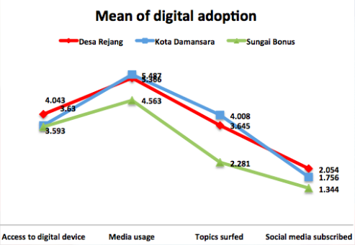
01
Children Of PPR Have Limited Ways To Access Digital Devices And The Internet.

Slide 6
02
The children that have access to digital technologies do not seem to have better literacy when compared to the children that do not have the access
100%
75%
Tablets
9%
50%
Notebook/computers
14.8%
25%
Smartphones
76.2%
0%
Online class
Youtube
Gaming

Slide 7
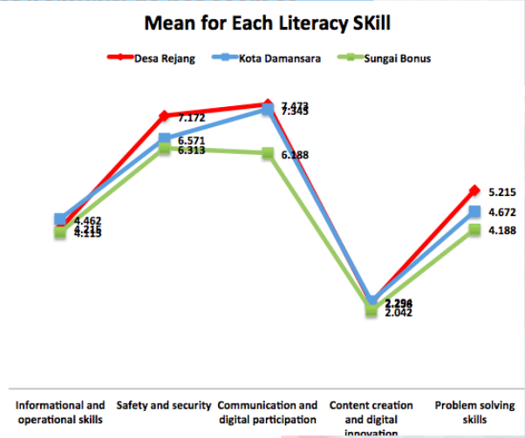
03
The children have the basic skills to operate and manage digital devices but are not technically able to productively exploit the digital media hence they have minimal digital literacy

Slide 8
Recommendations
Leverage on existing community programs
Need for an enhanced multi-stakeholder partnership
Equip campaign or program that focuses on digital penetration with simple modules and guides
simple brochures and attractive youtube videos
Focus on the potential
strengthened partnerships with more child-specific educational and training programs
more innovative collaborations with the arts and gaming communities
Strategic collaboration with emerging tech start-ups
Awareness raising and advocacy initiatives to highlight the importance of digital parenting
More children-focused activities at the Pusat Internet Komuniti
Awareness-raising and advocacy campaigns to emphasize the value of digital parenting
Digital safety campaigns and digital parenting modules should aim at building digitally resilient children
Family digital use
Tailor programs to the needs of the community it represents.
Strategically market programs to the intended audience
Exploit social media platforms
Collaborate with resident association

Slide 9
The children at the PPR, like most children in today's world, have become digital by default in that they are easily exposed to the digital world despite having limited resources and devices.
The danger that these children face is that they are engaging in a digital world that is full of possibilities without proper knowledge and skills. Going into this world blindly can be detrimental. Therefore, it is important that the children be armed with enough skills that can help them manoeuvre through the digital world safely and successfully.

