Slide 1
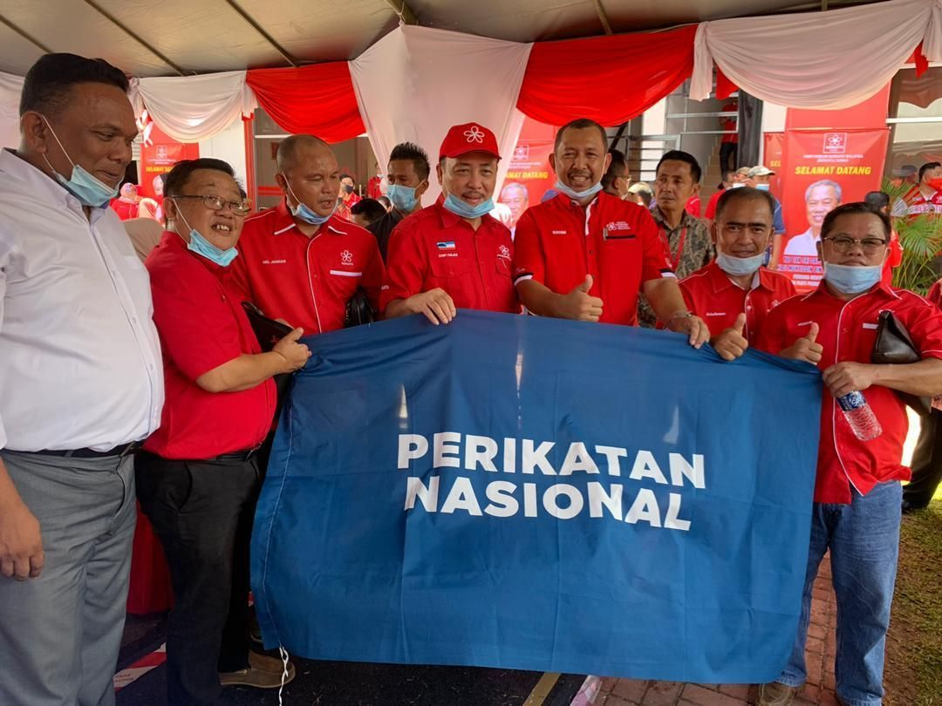
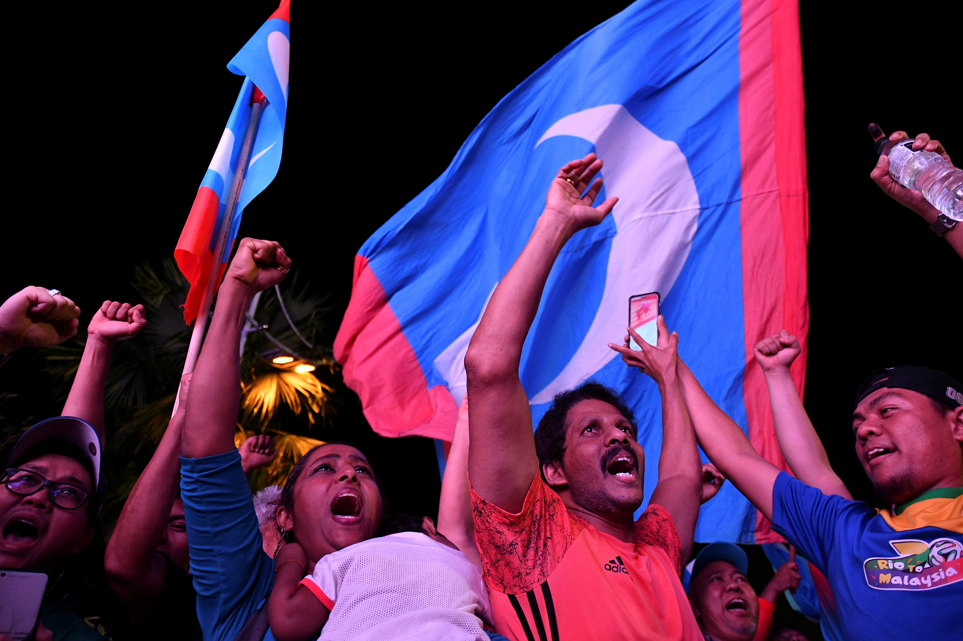
PERCEIVING PARTY ATTRIBUTES AND SUPPORT OF PERIKATAN NASIONAL & PAKATAN HARAPAN
Presenters:
Dato’ Sri Dr. Syed Arabi Idid &
Dr. Tengku Siti Aisha Tengku Mohd Azzman
Department of Communication, IIUM

Slide 2
INTRODUCTION
PH is a component party of DAP, PKR and Amanah while Perikatan Nasional (PN) houses BERSATU, PAS and STAR.
The Pakatan Harapan government in 2018 lost its majority in February 2020 with the withdrawal of BERSATU, which then began the government with support from PAS, GPS, STAR and UMNO.
Specifically, this study will focus on perception on party attributes (PH versus PN) across age and race, and factors that influence support for PH and PN

Slide 3
Research on parties
Political parties are important in the electoral system.
In democracies, political parties campaigned to form government.
Many studies are done on viability of parties and partisanship.
Studies on political parties have not touched on their attributes but instead have focused on their role in the electoral system.

Slide 4
Research on parties
Malaysia has been under Perikatan / Barisan Nasional from independence until they were outvoted in 2018.
Many parties have been contesting the elections , but the dominant national parties appear to be BN, PAS, DAP, PKR.

Slide 5
Methodology
Study conducted in July 2020, included 820 respondents face- to-face nationwide to understand voter perception of the two parties (PN versus PH).
Respondents were questioned on political beliefs, media use, optimism, support for government, party attributes and voting behavior.
IVs = media use, support for current government, optimism, DVs = party attributes that indicates support for political parties (PH versus PN),
All measures achieved good reliability; CA ranged from 0.77 to 0.96
Party attributes are based on 3 sub-items = party characteristic, perceiving the party as ‘my party’, and the party as ‘people party’
Respondents rated all 13 items related to party attributes based on Likert-scale scoring

Slide 6
Main measures used in the study (DV)
Items | Number of items & scale | Reliability (Cronbach alpha) | Mean | SD
Party Characteristic (PN) (Party attribute 1) | 3 items, (Likert scale, 1-5) | 0.77 | 3.17 | 0.79
Party for me (PN) (Party attribute 2) | 5 items, (Likert scale, 1-5) | 0.95 | 3.41 | 1.00
Party for the people (PN) (Party attribute 3) | 5 items, (Likert scale, 1-5) | 0.94 | 3.38 | 1.05
Party Characteristics (PH) (Party attribute 1) | 3 items, (Likert scale, 1-5) | 0.81 | 3.03 | 1.04
Party for me @ my party (PH) (Party attribute 2) | 5 items, (Likert scale, 1-5) | 0.96 | 2.88 | 1.13
Party for the people (PH) (Party attribute 3) | 5 items, (Likert scale, 1-5) | 0.95 | 2.92 | 1.08

Slide 7
Demographic background (N = 820)
60 voters selected from each of the 14 states in Malaysia
Slightly more male respondents (51%), compared to females
More than half Malays (52%), one third Chinese (32%), remaining Indians and other minorities (16%)
Consist of young adults 18-35 years old (40%), middle aged adults (36 – 50 years old), and older adults, 51 and above (17%)
Majority were married (75%), and half were Muslims (56%)
Close to three quarters were from low-income households, with RM4000 or less (68%); only 7% earned RM8000 or more

Slide 8
Voting behavior
Voting behavior

Slide 9
Party attributes across age and race
Overall, respondents had an above average score in support for PN but saw it as a problematic party.
Malays were more favorable of PN compared to Chinese, Indians and other minorities.
Older Malaysians had a more favorable impression of PN
For PH, respondents were favorable of PH across some items.
PH is seen to have poor leadership, not handling issues on bribery, have internal conflicts, and need to champion the cause of the people.
PH has more support from Chinese and Indians voters, and are perceived more favorably among younger Malaysians (i.e., 18 – 35 years old)

Slide 10
Variable correlations for PN support
Variables |  | 1 | 2 | 3 | 4 | 5 | 6 | 7 | 8 | 9 | 10
TV | Pearson Correlation | 1
 | Sig. (2-tailed)
 | N | 820
Newspaper | Pearson Correlation | .188** | 1
 | Sig. (2-tailed) | <.001
 | N | 820 | 820
Radio | Pearson Correlation | .163** | .337** | 1
 | Sig. (2-tailed) | <.001 | <.001
 | N | 820 | 820 | 820
Twitter | Pearson Correlation | -0.051 | .138** | .207** | 1
 | Sig. (2-tailed) | 0.146 | <.001 | <.001
 | N | 820 | 820 | 820 | 820
Whatsapp | Pearson Correlation | 0.028 | 0.024 | .153** | .171** | 1
 | Sig. (2-tailed) | 0.416 | 0.496 | <.001 | <.001
 | N | 820 | 820 | 820 | 820 | 820
Optimism | Pearson Correlation | 0.048 | -0.061 | -0.004 | -0.062 | .107** | 1
 | Sig. (2-tailed) | 0.168 | 0.08 | 0.907 | 0.076 | 0.002
 | N | 815 | 815 | 815 | 815 | 815 | 815
Support for current government | Pearson Correlation | 0.014 | -.158** | -0.008 | -.075* | 0.053 | .731** | 1
 | Sig. (2-tailed) | 0.692 | <.001 | 0.824 | 0.032 | 0.131 | <.001
 | N | 813 | 813 | 813 | 813 | 813 | 808 | 813
PN Party Characeristic | Pearson Correlation | .100** | -.239** | -0.06 | -.210** | 0.049 | .274** | .504** | 1
 | Sig. (2-tailed) | 0.005 | <.001 | 0.091 | <.001 | 0.167 | <.001 | <.001
 | N | 802 | 802 | 802 | 802 | 802 | 797 | 800 | 802
PN is my party | Pearson Correlation | 0.051 | -.191** | -0.062 | -.147** | 0.029 | .524** | .670** | .555** | 1
 | Sig. (2-tailed) | 0.151 | <.001 | 0.08 | <.001 | 0.414 | <.001 | <.001 | <.001
 | N | 800 | 800 | 800 | 800 | 800 | 795 | 798 | 799 | 800
PN is party for the people | Pearson Correlation | .077* | -.212** | -0.049 | -.143** | 0.061 | .574** | .737** | .621** | .936** | 1
 | Sig. (2-tailed) | 0.028 | <.001 | 0.168 | <.001 | 0.081 | <.001 | <.001 | <.001 | 0
 | N | 805 | 805 | 805 | 805 | 805 | 800 | 803 | 802 | 800 | 805

Slide 11
Factors influencing support for PN
Newspaper use is negatively correlated with all party attributes: PN party characteristic (r = -.24, p < .001), PN is my party (r = -.19, p < .001), and PN is people party (r = -.21, p < .001)
TV use is positively correlated with PN party characteristic (r = .10, p < .05) and PN is people party (r = .08, p < .05)
Twitter use is negatively correlated with all party attributes: PN party characteristic (r = -.21, p < .001), PN is my party (r = -.15, p < .001), and PN is people party (r = -.14, p < .001)
Optimism is positively correlated with all party attributes: party characteristic (r = .27, p < .001), PN is my party (r = .52, p < .001), and PN is people party (r = .57, p < .001)
Support for the current government is positively correlated with all party attributes: party characteristic (r = .50, p < .001), PN is my party (r = .67, p < .001), and PN is people party (r = .74, p < .001)

Slide 12
Variable correlations for PH support
Variables |  | 1 | 2 | 3 | 4 | 5 | 6 | 7 | 8 | 9 | 10
TV | Pearson Correlation | 1
 | Sig. (2-tailed)
 | N | 820
Newspaper | Pearson Correlation | .188** | 1
 | Sig. (2-tailed) | <.001
 | N | 820 | 820
Radio | Pearson Correlation | .163** | .337** | 1
 | Sig. (2-tailed) | <.001 | <.001
 | N | 820 | 820 | 820
Twitter | Pearson Correlation | -0.051 | .138** | .207** | 1
 | Sig. (2-tailed) | 0.146 | <.001 | <.001
 | N | 820 | 820 | 820 | 820
WhatsApp | Pearson Correlation | 0.028 | 0.024 | .153** | .171** | 1
 | Sig. (2-tailed) | 0.416 | 0.496 | <.001 | <.001
 | N | 820 | 820 | 820 | 820 | 820
Optimism | Pearson Correlation | 0.048 | -0.061 | -0.004 | -0.062 | .107** | 1
 | Sig. (2-tailed) | 0.168 | 0.08 | 0.907 | 0.076 | 0.002
 | N | 815 | 815 | 815 | 815 | 815 | 815
Support for current government | Pearson Correlation | 0.014 | -.158** | -0.008 | -.075* | 0.053 | .731** | 1
 | Sig. (2-tailed) | 0.692 | <.001 | 0.824 | 0.032 | 0.131 | <.001
 | N | 813 | 813 | 813 | 813 | 813 | 808 | 813
PH Party Characteristics | Pearson Correlation | -0.062 | .197** | .081* | .169** | -0.049 | -.326** | -.457** | 1
 | Sig. (2-tailed) | 0.081 | <.001 | 0.021 | <.001 | 0.169 | <.001 | <.001
 | N | 800 | 800 | 800 | 800 | 800 | 795 | 798 | 800
PH is my party | Pearson Correlation | -0.012 | .138** | .124** | .121** | -0.061 | -.229** | -.415** | .618** | 1
 | Sig. (2-tailed) | 0.744 | <.001 | <.001 | <.001 | 0.083 | <.001 | <.001 | <.001
 | N | 797 | 797 | 797 | 797 | 797 | 792 | 795 | 795 | 797
PH is party for the people | Pearson Correlation | 0.009 | .152** | .133** | .126** | -.070* | -.216** | -.404** | .632** | .948** | 1
 | Sig. (2-tailed) | 0.794 | <.001 | <.001 | <.001 | 0.048 | <.001 | <.001 | <.001 | 0
 | N | 797 | 797 | 797 | 797 | 797 | 792 | 795 | 795 | 795 | 797

Slide 13
Factors influencing support for PH
Newspaper use is positively correlated with: PH party characteristic (r = .20, p < .001), PH is my party (r = .14, p < .001), and PH is people party (r = .15, p < .001)
Radio use is positively correlated with: PH party characteristic (r = .08, p < .001), PH is my party (r = .12, p < .001), and PH is people party (r = .13, p < .001)
Twitter use is positively correlated with: PH party characteristic (r = .17, p < .001), PH is my party (r = .12, p < .001), and PH is people party (r = .13, p < .001)
WhatsApp use is negatively correlated with: PH is people party (r = -.07, p < .05)
Optimism is negatively correlated with: PH party characteristic (r = -.33, p < .001), PH is my party (r = -.23, p < .001), and PH is people party (r = -.22, p < .001)
Support for the current government is negatively correlated with: PH party characteristic (r = -.45 p < .001), PH is my party (r = -.42, p < .001), and PH is people party (r = -.40, p < .001)

Slide 14
Discussion
Media use is mainly a positive influence on support for PH except for the use of WhatsApp, while TV use is a positive influence on support for PN
Optimism is a positive influence for PN in terms of support for PN, while optimism is a negative influence for PH, where those who are less optimistic about the condition of their own condition, their family and their country, are more likely to have increased support for PH
Same pattern with support for current government; it has a negative influence for PH supporters. When there is decreased confidence and support for the current government, they are more likely to increase support for PH. Thus, support for PH could be expressed with greater mistrust with current government

Slide 15
Discussion
Factors that influence support for PN and PH varied across parties, and overall pattern tends to indicate opposing trends
Overall, media use is not strongly correlated with support for both parties and correlations appears to vary across media type. To garner continued support, strategies should be tailored based on the platform, and to target specific demographics, e.g., PH might use Twitter to target young non-Malays, while TV may work for older Malays who support PN
More important is tackling current issues like high cost of living, increased price of consumer products, and rising crime; this may increase optimism among the people and encourage them to support parties currently ruling the government. When this is achieved, support for parties will follow suit

Slide 16
Thank you for your time and attention

