Slide 1
TRENDS AND ISSUES OF DISASTER MITIGATION IN THE COMMUNITY
NURUL’AIN AHAYALIMUDIN, Ph. D, RN, CEN
DEPT OF CRITICAL CARE NURSING
KULLIYYAH OF NURSING

Slide 2
OUTLINE
Disaster trends and issues.
The efforts that have been made by several countries on disaster mitigation.
Challenges in disaster mitigation.

Slide 3
WHERE TO RETRIEVE DATA ON DISASTER OCCURENCES?
EM-DAT contains essential core data on the occurrence and effects of over 22,000 mass disasters in the world from 1900 to the present day.
The database is compiled from various sources, including UN agencies, non-governmental organisations, insurance companies, research institutes and press agencies.

Slide 4
OVERVIEW OF DISASTER OCCURRENCES

Slide 5
OVERVIEW OF DISASTER OCCURRENCES

Slide 6
OVERVIEW OF DISASTER OCCURRENCES

Slide 7
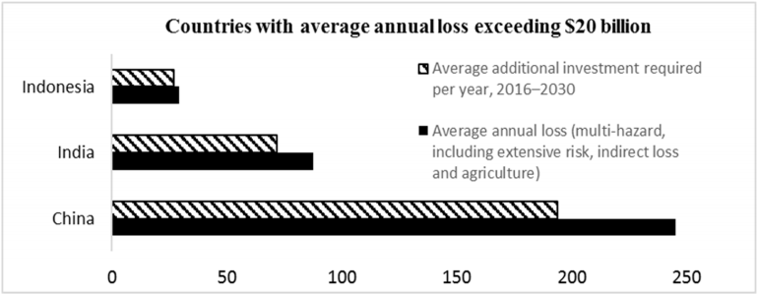
OVERVIEW OF DISASTER OCCURRENCES

Slide 8
OVERVIEW OF DISASTER OCCURRENCES

Slide 9
WHAT IS DISASTER MANAGEMENT?

Slide 10
MITIGATION VERSUS PREVENTION
Mitigation means to reduce the severity of the human and material damage caused by the disaster.
Permanent reduction of the risk of disaster
Prevention is to ensure that human action or natural phenomena do not result in disaster or emergency.

Slide 11
WHAT IS MITIGATION?
“Primary” mitigation: reducing the PRESENCE of the Hazard and reducing Vulnerability
“Secondary” mitigation: reducing the EFFECTS of the Hazard (Preparedness)

Slide 12
WHAT IS MITIGATION?
Principal objectives of mitigation
Save lives.
Reduce economic disruption.
Decrease vulnerability/increase capacity.
Decrease chance/level of conflict.
RISK REDUCTION

Slide 13
WHAT IS DISASTER MITIGATION?
Disaster mitigation measures are those that eliminate or reduce the impacts and risks of hazards through proactive measures taken before an emergency or disaster occurs.
Activities may include the creation of comprehensive, proactive tools that help decide where to focus funding and efforts in risk reduction.
The measures may be structural (e.g. flood dikes) or non-structural (e.g. land use zoning).

Slide 14
WHAT IS DISASTER MITIGATION?
Engineering | Conflict resolution | Economic
Spatial planning | Societal | Management and institutionalisation

Slide 15
Engineering

Slide 16
Engineering
Disaster mitigation measures depend on the type of disasters struck the countries.
Tsunami – early warning system
Floods – tunnel, floodway
Landslides – slope management
Earthquake – quake resistant architecture

Slide 17
SMART TUNNEL
The Stormwater Management And Road Tunnel, is a storm drainage and road structure in Kuala Lumpur, Malaysia.
The 9.7 km tunnel is the longest stormwater drainage tunnel in Southeast Asia and second longest in Asia.
Completed in 2007, SMART cost US$515 million to build but, over the 30-year concession period, it is expected to generate savings of US$1.58 billion by preventing possible flood damage, and another US$1.26 billion in savings from traffic congestion.

Slide 18
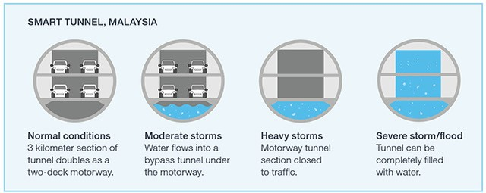
SMART TUNNEL

Slide 19
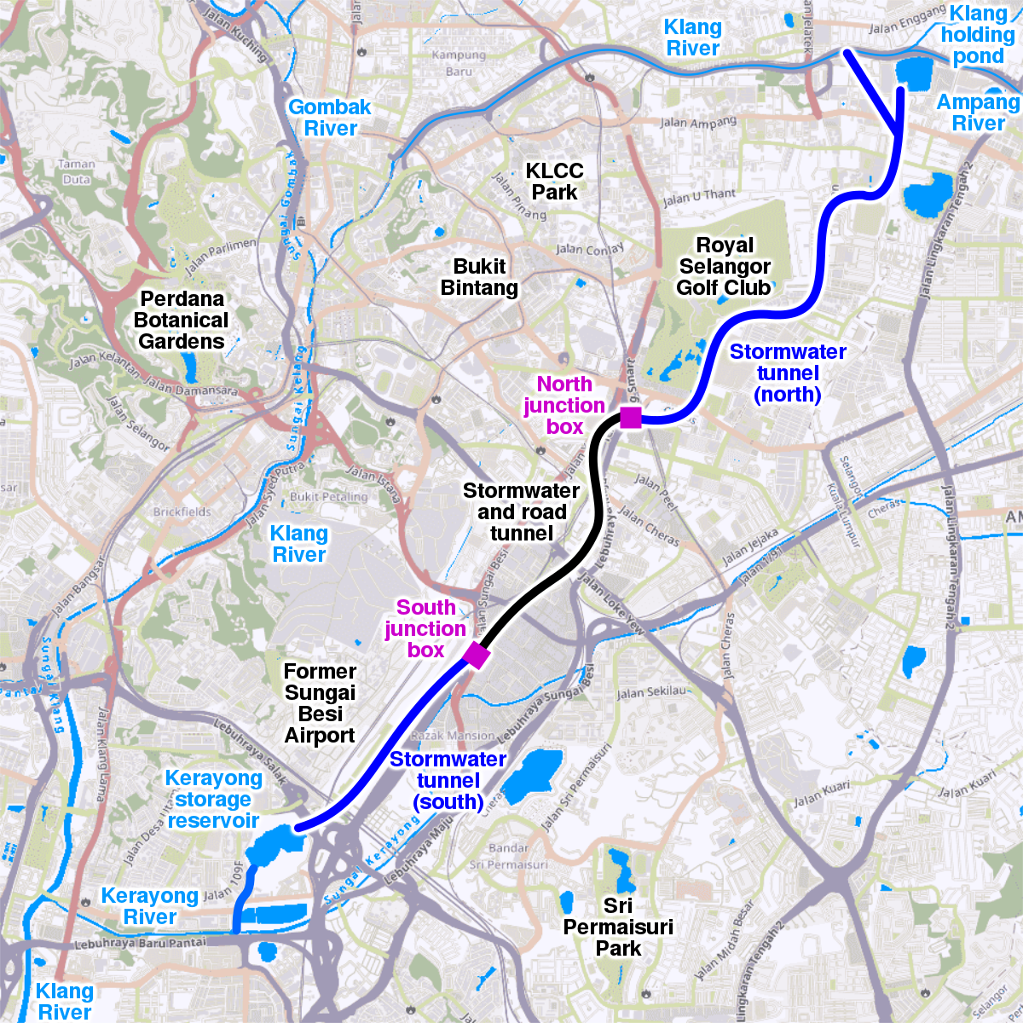
SMART TUNNEL

Slide 20
Engineering
The Red River Floodway is an artificial flood control waterway in Western Canada.
It is a 47 km (29 mi) long channel which, during flood periods, takes part of the Red River's flow around the city of Winnipeg, Manitoba to the east and discharges it back into the Red River below the dam at Lockport.
Construction of the Floodway started on November 27th, 1962 and finished in March 1968.
The total cost at the time was $63 million (CAD), equivalent to approximately $505 million today.

Slide 21
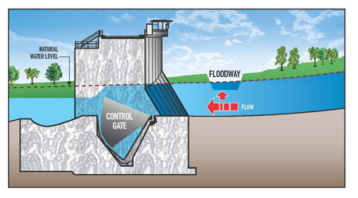
RED RIVER FLOODWAY

Slide 22
Conflict resolution

Slide 23
Conflict resolution
Natural disasters affect more than the physical infrastructure in areas they hit.
They also impact social and political dynamics.
In situations of active armed conflict, this raises a question: can a disaster change the dynamics of conflict and provide an opportunity for peace?

Slide 24
Conflict resolution
Within a year of the 2004 Indian Ocean tsunami, Indonesia and the Free Aceh Movement signed a peace agreement, government troops pulled out of Aceh, and rebels disarmed, ending a decades-long separatist insurgency in the country.
As many argue, the disaster strengthened political will toward peace and enabled successful negotiations.

Slide 25
Conflict resolution
BUT!
Disaster – an opportunity for conflict escalation.
The example of Sri Lanka after the Indian Ocean tsunami demonstrates that.
Creation of a joint aid mechanism (P-TOMS) between the government of Sri Lanka and Liberation Tigers of Tamil Eelam.
However, neither of the parties sought peace and continued to perceive winning the war as a viable option.

Slide 26
Economics

Slide 27
Economics
Diversification of economic activity.
Economic incentives (grants loans, taxes).
Insurance.

Slide 28
Spatial planning

Slide 29
Spatial planning
Decentralisation of elements at risk.
Control of population density.
Design of services and roads.
Land use regulation.

Slide 30
Societal

Slide 31
Societal
Public information campaigns.
Education.
De-sensationalise hazards.
Community involvement.
Drills.

Slide 32
Management and institutionalisation

Slide 33
Management and institutionalisation
Education and training.
Research.
Technical expertise.
Strengthening the capability of local authorities.

Slide 34
WHAT ACTIONS TAKEN FOR DISASTER RISK REDUCTION?
Priority 1. Understanding Disaster Risk.
Priority 2. Strengthening Disaster Risk Governance to Manage Disaster Risk.
Priority 3. Investing in Disaster Risk Reduction for Resilience.
Priority 4. Enhancing Disaster Preparedness for Effective Response to “Build Back Better” in Recovery, Rehabilitation and Reconstruction.

Slide 35
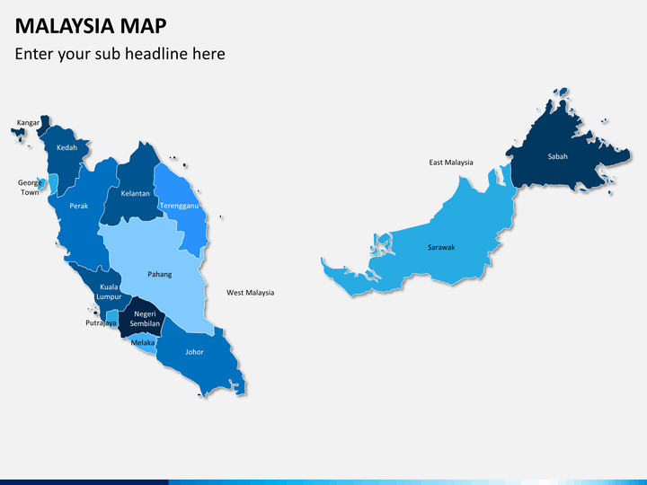

Slide 36
Priority 1. Understanding Disaster Risk
Priority | MALAYSIA | INDONESIA
Priority 1 | Hosts a Disaster Portal (Portal Bencana) which contains up-to-date information on regional flooding Cataloguing real-time events and displaying them by utilising GIS technology. Mapping and monitoring hazard and disaster-related data. For landslide risks, the Slope Engineering Branch has increased the availability of information focused on slope conditions (Slope Management and Risk Tracking, SMART). Identified flood and landslide risks, but also will utilise the scientific risk assessment information to plan local disaster management measures. | Analysing, collecting and managing disaster and climate risk-related data (post-disaster and potential losses and probabilities). The National Meteorological Organization is the main body providing real time hazard monitoring and maintaining data on hydrometeorological hazards, volcanic and seismic activity. The InaRisk platform was launched in 2015 as a web-based portal for visualising spatial distribution of disaster risk assessment results in the country for DRR planning and monitoring. The Indonesia Disaster Database system was developed in 2006 based on the DesInventar system. Mainstream risk mapping and risk-informed planning, and within the provinces it supports localised, contextual DRR planning.

Slide 37
Strengthening Disaster Risk Governance to Manage Disaster Risk
Priority | MALAYSIA | INDONESIA
Priority 2 | National guidelines for disaster management are based on the Directive No. 20: National Policy and Mechanism on Disaster Management and Relief. Run by the National Disaster Management Agency (NADMA), supported by Malaysia Civil Defence Force, the Royal Malaysia Police, Fire and Rescue Department, and the Social Welfare Department. However, the scope of policies intended to address disasters is rather limited, especially in terms of DRR and CCA given their heavy reliance on response and recovery. | the Indonesian National Board for Disaster Management (BNPB) is the country’s central governing body for all disaster-related activities. The Indonesian National Armed Forces and Indonesian National Police are also important contributors to disaster response. The Law No. 24 of 2007 concerning Disaster Management by laying out provisions outlining national and regional responsibilities. Others, the Government Regulation No. 22 (managing disaster assistance) and No. 23 (role of international agencies and foreign NGOs in DM). The National Action Plan for Disaster Risk Reduction (20102012) and the National Disaster Management Plan (2010-2014) have been implemented.

Slide 38
Investing in Disaster Risk Reduction for Resilience
Priority | MALAYSIA | INDONESIA
Priority 3 | Little detail is available about the exact financing of DRR and CCA in Malaysia. National Disaster Relief Trust Fund is the organization channeling donations in the case of a specific, large-scale disaster. Malaysia Civil Defence Force (MCDF) is one of government agency responsible to enhance preparedness and resilience of community towards disaster - 2019 MCDF spent RM 686,000 (USD 16,700) for the MCDF Public Preparedness Program and RM 2,062,992 (USD 501,274) for disaster response and preparedness course. Structural mitigation projects, alone, have increased from RM 1.79 billion in the period 2001-2005 to RM 5.81 billion in 2006-2010, including investment in major projects such as the Stormwater Management and Road Tunnel (SMART). | Derived from the General Treasury to be distributed through the Rehabilitation and Reconstruction Fund. The On-call Fund intended to release funding during emergencies. World Bank also approved a loan of US$ 60 million under the Indonesia Disaster Resilience Initiatives Project to support the government’s efforts to improve holistic DRM. Cat (catastrophe) bonds would allow the spreading out of disaster costs across several years by transferring risks to capital markets to help securing financing for recovery and rebuilding initiatives. Disparities still exist, for example, the funding for the BNPB during a five-year period between 2015 and 2019 received over US$ 645 million, whereas the budget of regency level disaster offices was significantly lower, averaging at around US$ 400,000.

Slide 39
Enhancing Disaster Preparedness for Effective Response to “Build Back Better” in Recovery, Rehabilitation and Reconstruction
Priority | MALAYSIA | INDONESIA
Priority 4 | Standard Operating Procedures have been developed for each disaster based on the National Security Council’s Directive No. 20. There are 79 agencies involved in disaster management. Malaysia is home to the ASEAN’s Disaster Emergency Logistics System (DELSA), launched in December 2012 to host regional relief stockpile. The Malaysian National Tsunami Early Warning System was established in 2004 following the Indian Ocean Tsunami, with 23 sirens installed throughout the coastal regions. The intention to move away from reconstruction and recovery towards improving systems in the rebuilding phases to improve their resiliency against disasters. | Maintains a comprehensive network of end-to-end early warning systems, including the Tsunami Early Warning System (InaTEWS). Most people in Indonesia receive their disaster information via alternative media channels. Building Back Better (BBB) is also elemental to avoid reproducing unnecessary risks by replacing destroyed infrastructure and housing.

Slide 40
CHALLENGES IN DISASTER MITIGATION
Unproportionate disaster management planning between top-down and bottom-up approaches.
Lack of coordination in the entire disaster management cycle and greater focus on the disaster emergency response stage.
Lack of planning of a long-term recovery (post-disaster) process, which results in low level community and stakeholder resilience.

Slide 41
ICN DISASTER NURSING COMPETENCIES
Mitigation/prevention
policy development and planning.
risk reduction, disease prevention and health promotion.
Preparedness
ethical practice, legal practice and accountability.
communication and information sharing.
education and preparedness.

Slide 42
ICN DISASTER NURSING COMPETENCIES
Response
care of the community
care of individuals and families
psychological care
care of vulnerable populations
Recovery/rehabilitation
long-term recovery of individuals, families and communities.

Slide 44
CONCLUSION

Slide 47
QUIZ 1
Describe how would you identify the hazards of concern in your country, identify the risk, and identify what is vulnerable.

Slide 48
QUIZ 2
Identify mitigation activities appropriate to your selected sectors.

Slide 49
QUIZ 3
Describe the implementation strategy of one of the mitigation activities.

Slide 51
REFERENCES
https://www.icn.ch/sites/default/files/inline-files/ICN_Disaster-Comp-Report_WEB_final.pdf
https://apps.who.int/disasters/repo/5514.pdf

