Slide 1
COVID 19:Assessment of Crisis Management
in China and the United States
IPS CASS 中国社会科学院政治学研究所
Mao Dun
Institute of Political Science, Chinese Academy of Social Science
Lee Pei May
Department of Political Science, International Islamic University Malaysia

Slide 2
IPS CASS 中国社会科学院政治学研究所
Introduction
To explain how China and the United States, with different governance models, responded to the COVID-19 pandemic.
The presentation is divided into two parts:
Compare the main characteristics of governance models of China and the US
Examine how two contrasting governance models shape government responses during the Covid-19
According to Lin (2018), ‘governance is the process of interaction and decision-making among the stakeholders involved in a collective issue’.

Slide 3
IPS CASS 中国社会科学院政治学研究所
Characteristics of the Governance Model of China
Leading role of the government (party)
Upholds the leadership of the government in all aspects of governance.
Powerful government
Hierarchical governance and ‘selective’ civil society participation
Play supporting role in the governance process
Selective in the sense that it is guided and its purpose is to complement the work of the government

Slide 4
IPS CASS 中国社会科学院政治学研究所
Characteristics of the Governance Model of the US (Western)
A shift in power from the government to civil society actors
The leadership of the government in social governance should be removed
Promote equal participation in the decision-making process
Emphasis on decentralisation and autonomous civil society
Self-organising networks can better provide directions to society
Cooperation between public and private sectors

Slide 5
IPS CASS 中国社会科学院政治学研究所
Three aspects for comparison
Initial responses to the crisis
Management of important resources during containment period
The role of civil society during the pandemic

Slide 6
IPS CASS 中国社会科学院政治学研究所
Initial responses to the Covid-19 in China
Moving Toward Centralised Command in China
When the unknown pneumonia was first detected in Wuhan, there were health workers who expressed concerns over the possibility of another SARs-like outbreak.
To maintain stability, Wuhan government did not immediately inform the public.
National Health Commission was sent to Wuhan and central leadership decided to take control of the situation in Wuhan.
A lockdown was implemented in Wuhan on 23 January 2020.
On 25 January 2020, Central Leading Group (CLG) for Covid-19 was formed.
CLG went to Wuhan to inspect and direct the efforts to prevent and control Covid-19.
Setting up CLG is to ensure that effective and coordinated responses to Covid-19 can be achieved.

Slide 7
IPS CASS 中国社会科学院政治学研究所
Initial responses to the Covid-19 in the US
Sharing of responsibilities
The U.S. government was able to rapidly set up a White House Coronavirus Task Force.
While the establishment of the task force can be seen in a positive light as the federal government proactively trying to form a national response, the task force faced a number of challenges.
Conflicting opinions about the most efficient approaches to manage the pandemic.
The disagreements were not resolved and instead took place publicly.
The mixed messages relayed to the people caused confusion and subsequently distrust toward the government.
State governments called for greater intervention from the federal government, the latter refused to take the leading role.
Rather than providing the necessary resources for crisis control, federal leadership stressed the role of state governments in procuring the medical resources.

Slide 8
IPS CASS 中国社会科学院政治学研究所
Management of important resources during containment period in China
The Chinese government has insisted on maintaining its core position in the governing system.
The emergency command mechanism in China is “a top-down system with unified command”.
Central government can make timely decisions without excessive constraints from various local interest groups, and the local governments must rigorously enforce orders from the centre.

Slide 9
IPS CASS 中国社会科学院政治学研究所
Management of important resources during containment period in the US
In Western governance, the idea of sharing resources and creating a better environment through cooperation is inspiring; yet, it is “hard to realise in reality due to pervasive and deep network failures” (Ramesh, Wu & Howlett, 2015, p. 356).
All states of the U.S., along with the federal government, were bidding against each other to secure medical supplies.
As exemplified by the U.S. COVID-19 response, the lack of a competent and centralised decision-maker to systematically coordinate and allocate medical resources during crisis can prove to be fatal.

Slide 10
IPS CASS 中国社会科学院政治学研究所
The role of civil society in China during the pandemic
Both governance models encourage participation of various civil actors.
In China’s case, civil engagement was guided, often aimed to complement the role of the government.
Social organisations were mobilised and guided by Wuhan Civil Affairs Bureau to participate in pandemic control.

Slide 11
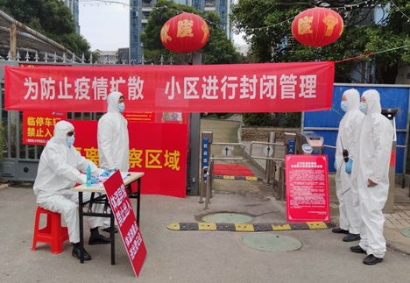
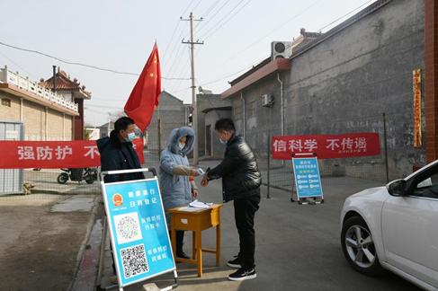
IPS CASS 中国社会科学院政治学研究所
Notes:
Here are community checkpoints in China, the left one is in urban area, the right one is in village. These checkpoints formed a non-medical method of stopping COVID-19 from spreading.

Slide 12
IPS CASS 中国社会科学院政治学研究所
The role of civil society in the US during the pandemic
A standard practice in Western governance is sharing of responsibilities.
Diverse interests cause fragmented and uncoordinated responses during the COVID-19.

Slide 13
IPS CASS 中国社会科学院政治学研究所
Conclusion
The governance model of China has demonstrated the state capabilities to take rapid and decisive decisions in a timely manner during crisis.
The governance model of the US can cause delay in crisis management.
Governance model of China may raise concerns that the leading role of the state in governance process means that the needs and demands of individuals and groups cannot be fully met.
This study does not intend to argue which governance model fared better in managing the Covid-19 but to reveal the strengths and weaknesses of both models.

