Slide 1
Fake News in the Malaysian 14th General Election
Asst. Prof. Dr. Mahyuddin Daud
Department of Civil Law
Ahmad Ibrahim Kulliyyah of Laws
International Islamic University Malaysia

Slide 2
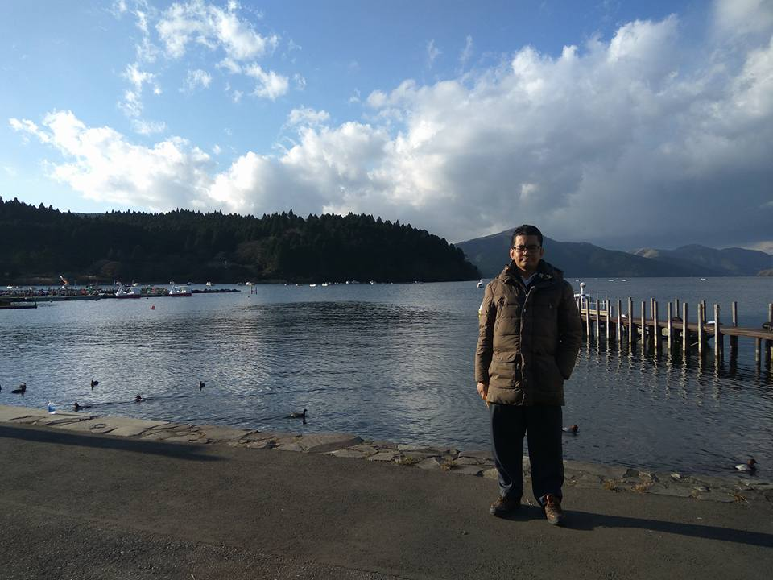
Name: Dr. Mahyuddin Daud
Born in Ipoh, Perak
Education: Bachelor of Laws (LLB) Hons IIUM, Master of Laws (LLM) UiTM, Doctor of Philosophy (Cyber Law) IIUM
Teaching: Law of Contracts, Law of Torts, Malaysian Legal System
Research areas: Cyber Law, Regulation of the New Media, Information Technology Law
Administrative position: Director, Sports Development Centre (present)
Former Deputy Dean (Student Affairs)
Contact details: Civil Law Department, Ahmad Ibrahim Kulliyyah of Laws, Universiti Islam Antarabangsa Malaysia
Email: mahyuddin@iium.edu.my

Slide 3
Issues
Fake news has been on the rise
Previous government used law & technology to restrict access to ‘illegal’ content
After GE14, more fake news, ministers were busy correcting misstatements

Slide 4
Legal frameworks
International
United Nations Joint Declaration on Freedom of Expression and ‘Fake News’, Disinformation and Propaganda
National
Communications & Multimedia Act 1998
Content Code
Anti-Fake News Act 2018

Slide 5
Findings
fake news remains to be visible and readable particularly on social media
censorship mechanism was not properly developed and transparent, leading to criticisms that previous government was denying freedom of expression and information.
government is taking a silent move towards Internet censorship, in honour of electoral manifesto to uphold freedom of expression and media.
However, with fake news being a global threat, the status quo cannot withstand for long.
Affirmative action needs to be taken in order to face the issues and challenges posed by fake news – and that could start with Internet censorship or classification

