Slide 1
Beyond the MIlItary MIght: EvolvIng Non-TradItIonal SecurIty Threat In the North AfrIcan RegIon
Dr. Ramzi Bendebka

Slide 2
Introduction
Most studies on North African security focus on traditional threats such as military issues and terrorism (Obi, 2006 ; Holden, 2013; Olsen, 2014; Solomon, 2015; Antwi‐Boateng, 2017). However, the non-traditional security challenges in North Africa have experienced significant changes in recent years (Seeberg, 2012; Srikanth, 2014). In addition to conventional military issues, the region has experienced many issues, such as the rise of new non-traditional security challenges, including drug trafficking, illegal immigration movements, smuggling, and, in general, the consequences of the global 'War on Terror' launched after the events of 9/11.

Slide 3
questions
How have non-traditional security challenges in North Africa evolved in recent years?
What are the new non-traditional security challenges faced by North Africa?
How do non-traditional security challenges influence North African countries?

Slide 4
Factors contributing to non-traditional security challenges in North Africa
FACTORS
Socio-Economic Issues
Conflict and War
International Intervention
Terrorism and Organized Crime
Environmental Issues

Slide 5
Unemployment and Poverty
Economic Impact
Displacement
Notes:
Unemployment and Poverty
High unemployment rates, especially among the youth, continue to plague North African countries. The International Labour Organization (ILO) reported that youth unemployment in the region was around 29.3% in 2020, one of the highest in the world.
Economic Impact: The economic slowdown due to political instability and the COVID-19 pandemic has further exacerbated poverty levels. For instance, in Tunisia, the poverty rate increased from 15.2% in 2019 to 21.5% in 2021, according to the Tunisian National Institute of Statistics.
Displacement: The International Organization for Migration (IOM) estimated that around 1.4 million North Africans were living abroad in 2020, with significant populations in France, Italy, and Spain.

Slide 6
Terrorism Statistics: According to the Global Terrorism Index 2022, North Africa witnessed over 500 terrorist incidents in 2021, resulting in approximately 2,000 deaths.

Slide 7
Environmental Issues
Desertification
Climate change
Notes:
Climate Change: According to the World Bank, the average annual temperature in the region has increased by 1.5°C since the early 20th century.
Desertification Data: According to the United Nations Convention to Combat Desertification (UNCCD), 65% of North Africa's agricultural land is degraded.

Slide 8
World Bank: Climate Change Knowledge Portal
International Labour Organization: Youth Employment Data
Tunisian National Institute of Statistics: Poverty Reports
International Organization for Migration: Migration Data
World Health Organization: COVID-19 Dashboard
International Telecommunication Union: Cybersecurity Index
Global Terrorism Index: Reports
United Nations Office on Drugs and Crime: World Drug Report
African Union: African Risk Capacity

Slide 9
Frame of the study
The framework: will be structured around three core issues: illegal immigration, water scarcity, drug trafficking and smuggling. Each issue will be analyzed through three lenses: domestic stability, the capacity of state institutions and trade, and regional instability.
  Procedure: Evaluate the direct and indirect effects of each issue on domestic stability, the capacity of state institutions, trade, and regional stability.
  Data collection: Gathered qualitative and quantitative data (reports, statistics, and policies) from international, regional and domestic organizations (e.g., United Nations, World Bank), national statistics agencies, and non-governmental organizations to provide empirical evidence on the extent and impact of each issue.

Slide 10
illegal immigration
drug trafficking and smuggling
water scarcity
Domestic Stability
Core Issues
State Institutions And Trade
Regional Instability

Slide 11
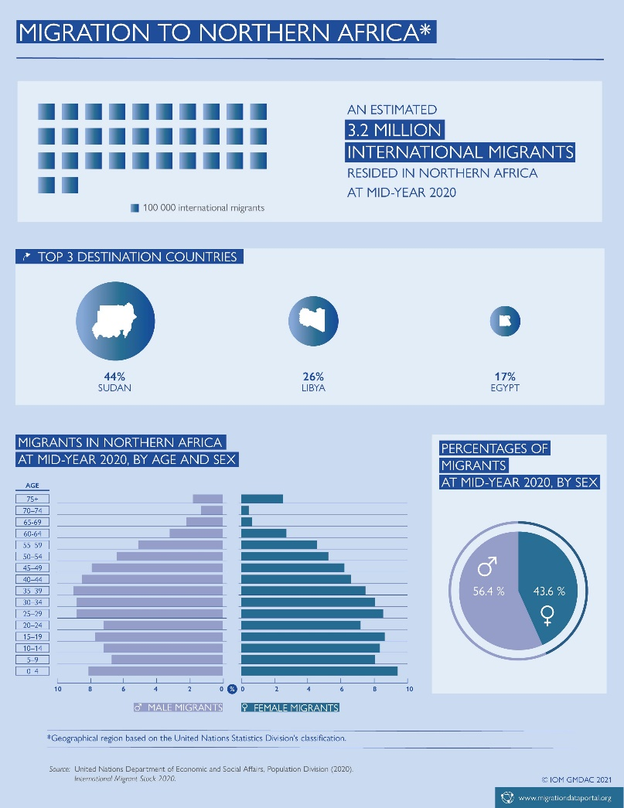

Slide 12
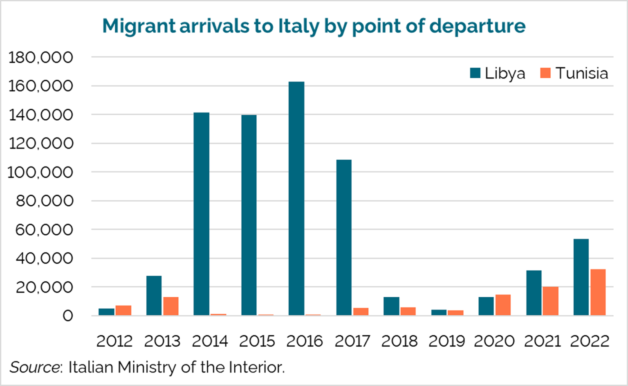

Slide 13
Illegal Immigration
1- DOMESTIC STABILITY
- Cultural Integration and Security Matters: The case of Tunisia and Libya.
Informal Economy: The case of Algeria.
2- CAPACITY OF STATE INSTITUTIONS AND TRADE
Weak Governance and Limited Resources
Informal Economies and Investment Climate
3-
Notes:
Illegal immigrants often come from diverse cultural and ethnic backgrounds, leading to challenges in integration. Host communities may experience cultural clashes, which can strain social cohesion.
Many illegal immigrants work in the informal economy, where labor rights are often ignored, and working conditions can be poor. This situation not only exploits immigrants but also undermines the formal labor market and reduces tax revenues for the state.

Slide 14
immediate Solutions | Permanent solutions
 | Political Stability
 | Collaboration and cooperation North and South

Slide 15
Water scarcity and destabilizing population in the country

Slide 16
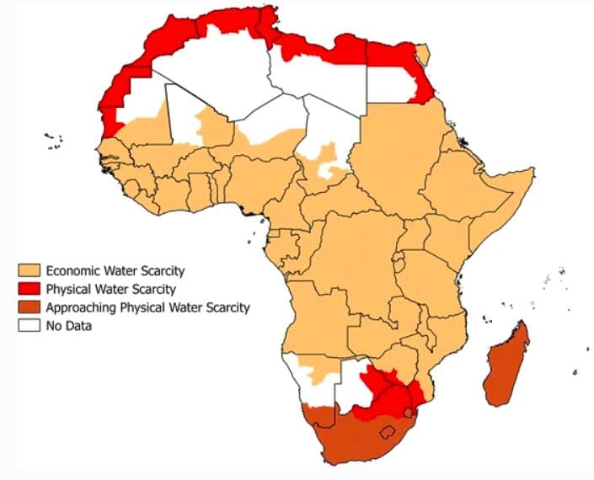

Slide 17
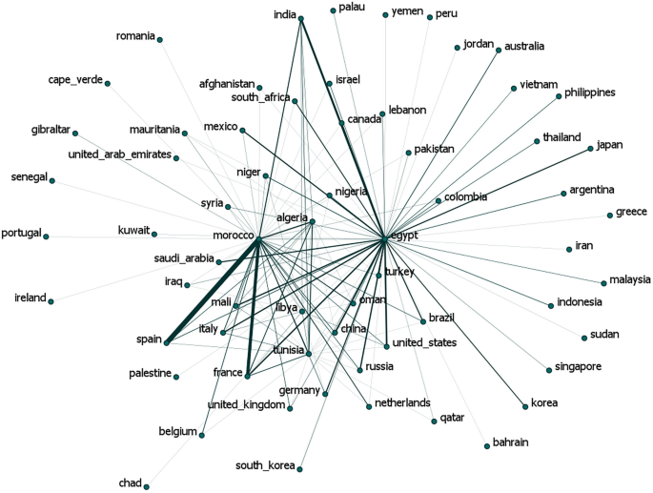

Slide 18
