Slide 1
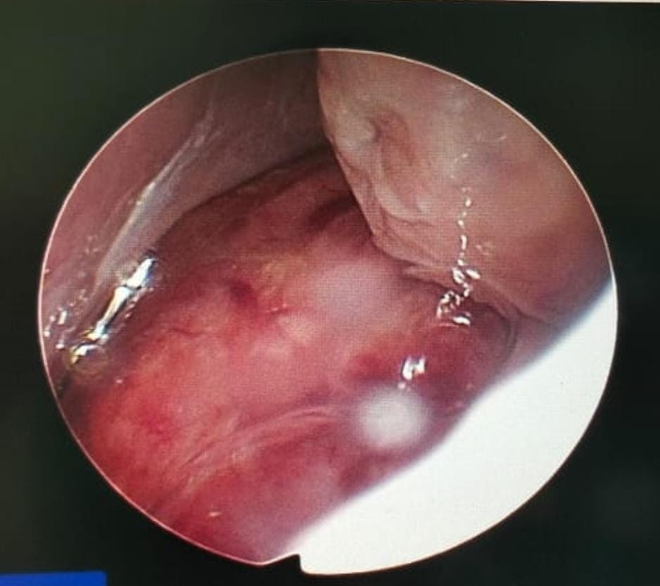
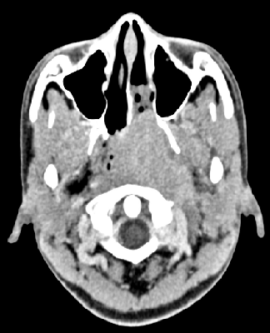
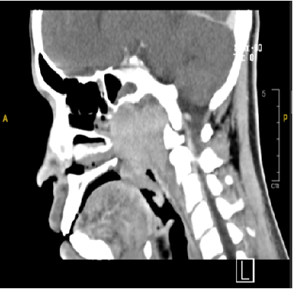
ABSTRACT
ID PC058
Adolescent Nasopharyngeal Carcinoma Mimicking Juvenile Nasopharyngeal Angiofibroma
Mohammad Aizat Kamal Bin Md Shamuddin¹, Raihanah Haroon¹, Azwan Halim A Wahab²
¹Department of Radiology, Kulliyyah of Medicine, International Islamic University Malaysia (IIUM) ²Department of Otolaryngology, Kulliyyah of Medicine, International Islamic University Malaysia (IIUM)
INTRODUCTION
Juvenile Nasopharyngeal Angiofibroma (JNA) is a rare benign but locally aggressive vascular tumour of nasopharynx which occurs almost exclusively in paediatric or adolescent population. Nasopharyngeal carcinoma (NPC) on the other hand, although rare in children; has a predilection for adolescents. Since the treatment approach for NPC and JNA varies greatly, it is crucial to distinguish between the two conditions on radiological imaging.
CASE DESCRIPTION
We hereby present a 14-year-old teenage male with complaint of painless neck swelling. Nasoendoscopy discovered a huge lobulated angry-looking mass occluding the entire left posterior choana, hence a provisional diagnosis of JNA was made and biopsy was not immediately undertaken. Subsequent computed tomography (CT) demonstrated a large heterogenous mass at the left nasopharyngeal region extending to the oropharynx and posterior choana. Though the left sphenopalatine foramen was not widened, the mass was seen minimally extending into it.
Given the patient’s age, size and location of the mass, combined clinical and radiological diagnosis concluded JNA as the primary diagnosis and endoscopic excision of the mass was planned. However, he presented about 1 month later in casualty with right nasal epistaxis whereby repeated nasoendoscopy showed a larger mass extending to the right nasopharynx with contact bleeding. The tissue biopsy performed was complicated with significant bleeding, further validating the suspicion of JNA. Histopathological diagnosis otherwise revealed undifferentiated carcinoma. The patient otherwise showed good response to chemoradiation.
DISCUSSION
JNA is a rare benign but locally aggressive vascular tumor of nasopharynx which occurs almost exclusively in pediatric or adolescent population, while NPC had predilection for adolescents although very rarely to be in paediatrics group. The final proof of diagnosis for this condition is histologic as both pathologies in similarities exhibit some common clinical presentation and radiological features.
Clinically, JNA patients usually presented with nasal obstruction, epistaxis, blood-stained sputum, and serous otitis media with rubbery vascular nasopharyngeal mass on examination. While radiologically, JNA usually locally invaded its surrounding structures and rarely extending intracranially, however features of CT images will be synonyms as in NPC.
Nasopharyngeal carcinoma, on the other hand, has a predilection for adolescents although very rarely found in children. Children aged between 10 and 19 years are the most common age group affected, which usually affected by genetic and environmental factors. Usually believing NPC in very young people is difficult and that is why the diagnosis is missed or delayed until the patient presents at a locally advanced stage. Non-specificity of symptoms besides neglecting the entity for differential diagnosis might be other reason for a delayed NPC in a young patient.
Clinically, NPC usually presented as painless cervical mass (70-90%), which is bilateral in 50% of cases. Radiologically, NPC typically seen as a heterogeneously enhancing mass arising from nasopharyngeal mucosa with skull base erosion, and invasion to its surrounding structures due to its malignant nature. Involvement of infratemporal and masticator spaces may also be seen during NPC progression. Although NPC may mimick JNA or other benign and malignant tumors in imaging, the course of illness, the aggressiveness of surrounding structures invasion and extension may be helping in directing the diagnosis of NPC.
CONCLUSION
It is imperative that preoperative imaging of patients with presumed JNA be carefully reviewed to ensure accurate diagnosis and proper management. Uncommon features seen on imaging, such as the lack of involvement of the pterygopalatine fossa, the presence of soft-tissue invasion, and cervical lymphadenopathy should alert the physician to malignant etiologies, such as NPC, and the radiologist must be aware that NPC can occur in children and, therefore, should deliberately look for associated secondary diagnostic signs, and the clinician should be able to correlate clinical and radiological findings for making an accurate diagnosis.
Figure 1: Nasal endoscope showed a huge mass occluding the entire left posterior choana likely arising from posterior to middle turbinate.
REFERENCES
Shahid Hassan et AL, Appraisal of clinical profile and management of juvenile nasopharyngeal angiofibroma in Malaysia, Malaysian Journal of Medical Sciences, Vol. 14, No. 1, January 2007 (18-22)
2. Saleh Mohebbi et AL (2019), From Juvenile Nasopharyngeal Angiofibroma to Nasopharyngeal Carcinoma; A Rare Case Report of Nasopharyngeal Mass, Bull Emerg Trauma 2019;7(4):424-426
Figure 2: CECT neck showed a large lobulated heterogenously enhanced mass (yellow arrowheads) at the left naspharynx. It extends cranially, abutting the clivus and floor of sphenoid bone.
Medical Research Symposium 2023

Slide 3
CT NECK And PNS (23/02/21: Large lobulated heterogenously enhanced mass at naspharyngeal region more toward the left side . It extend cranially, abutting clivus and floor of sphenoid bone. Erosion of the left sphenoid bone and part of the clivus. Inferiorly it extend minimally to oropharynx at level of mid C2. Anteriorly the mass is seen extending to both posterior choanae , more markedly on the left side. Minimally extension of the mass into the left sphenopalatine foramen and medial pterygopalatine fossa. Posteriorly mass isseen invading thethe left prevertebral tissue causing obliteration of FOR and torus tubarius Laterally mass is seen compressing left medial ptyregoid muscle withy no clear fat plane demarcation Multiple enlarged cervical nodesat level II and V
Nasal endoscope: Mass occluding lest posterior choana

