Slide 1
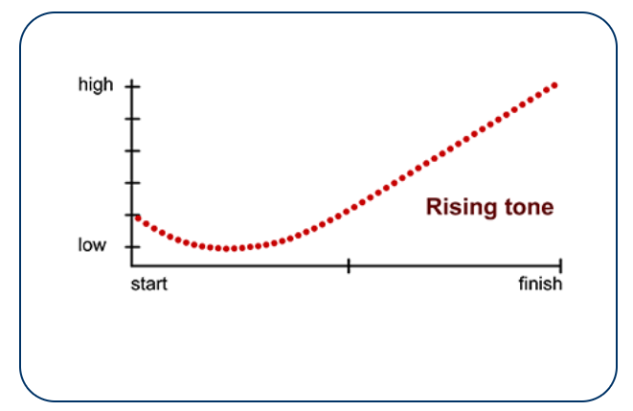
THE FUNCTIONS OF THE RISE TONE IN STRUCTURED SHORT STORY NARRATIONS BY MALAY ESL LEARNERS
Fazyudi ahmad nadzri
Zahariah pilus
Ridwan wahid

Slide 2
ORDER OF PRESENTATION
PURPOSE OF THE STUDY
RESEARCH QUESTIONS
DISCOURSE INTONATION
RISE TONE FUNCTIONS
GENDER DIFFERENCES
METHOD
FINDINGS
DISCUSSION

Slide 3
PURPOSE OF THE STUDY
Using the discourse intonation model developed by Brazil (1985, 1997), the study was undertaken to explain the characteristics of Malaysian English intonation, particularly the rise tone functions employed by Malay ESL learners based on their gender.

Slide 4
RESEARCH QUESTIONS
What functions does the rise tone serve in the story narration by Malay ESL learners?
To what extent are the rise tone functions employed by the learners significantly gender-different?

Slide 5
DISCOURSE INTONATION
Discourse Intonation (DI) was introduced by David Brazil.
It is based on the intonation of Standard British English (SBE).
Brazil (1997) asserts that intonation contains a discourse function and its choices are related to an on-going judgement of understanding that speakers make when communicating with their interlocutors.

Slide 6
DISCOURSE INTONATION
The choices are based on tone, prominence, key and termination, which are four components of intonation constituting a tone unit (Brazil, 1985; 1997).
A change in pitch enables speakers to produce different tone forms to perform different functions in speech.
Fall, fall-rise, rise, rise-fall and level are the five major tones in BE (Brazil, Coulthard & Johns, 1980).

Slide 7
THE RISE TONE FUNCTIONS
shared information (Brazil, 1985). (DI)
yes-no questions (Smith & Clark, 1993)
tag questions (Roach, 2009)
“unfinished business” (Bolinger, 1989)
non-final items in a list (Roach, 2009)

Slide 8
GENDER DIFFERENCES
Prevalent in Australian English – High rising terminal, HRT also known as ‘uptalk’ used by NS of Australian English (Warren, 2016)
Women were more likely than men to speak with a rise tone (Lakoff, 1973).
Females were found to use the rise tone more than men - Southern Californian (Ritchart & Arvaniti, 2013), and Canadian (Sando, 2009)

Slide 9
METHOD
60 Malay ESL students – 30 M & 30 F
A one-year foundation programme in TESL, UiTM Dengkil
Bilingual - Malay and English
Narrate a short story based on serial pictures
In a quiet room at the student's university
A Behringer B-2 Pro 2 Diaphragm Condenser Cardiod microphone attached to a laptop

Slide 10
METHOD
Praat (phonetics software that analyses speech) for acoustic analysis – tone forms
Brazil's (1985, 1997) Discourse Intonation model – tone functions
Independent samples t-tests – gender differences in tone functions

Slide 11
METHOD

Slide 12
FINDINGS

Slide 13
FINDINGS

Slide 14
FINDINGS

Slide 15
DISCUSSION
The tendency to use the rise tone to convey new information is different from the practice of BE speakers who use the fall tone for the function, as stated by Brazil (1985, 1997).
Using the rise tone to continue speaking and convey shared information conforms to the practice of BE speakers.

Slide 16
DISCUSSION
Although the Malay ESL learners did employ the rise tone to convey shared information, it was discovered that they also utilised the rise tone to communicate new information in ME.
Consequently, it is possible that ME speakers may be perceived by BE speakers as lacking conviction.

Slide 17
DISCUSSION
The female learners of ME in the current study tended to also utilise the rise tones more frequently than the male learners, as found in earlier research by Lakoff (1973), Sando (2009), Richart and Arvaniti (2013).

Slide 18
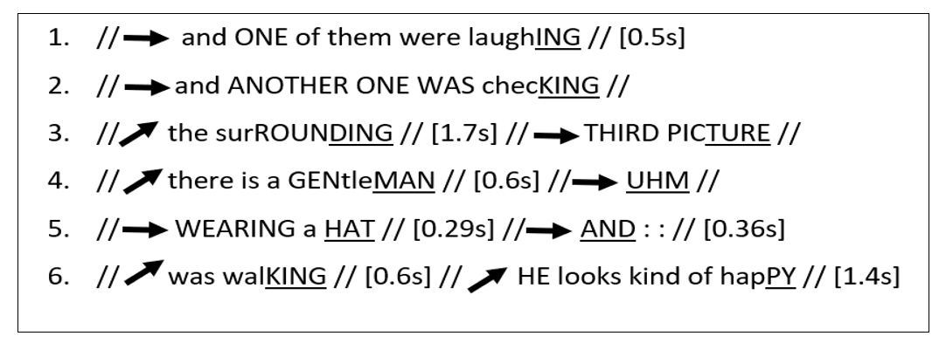
DISCUSSION

Slide 19
DISCUSSION
The learners' deployment of the rise tone to convey their new information was consistent and predictable as it was always placed on the final syllable following a series of level tones and incomplete phrases.

Slide 20
DISCUSSION
By using the rise tone, the females could have probably been more expressive and "emotionally involved" in their speeches than the male learners, who actually could be struggling with what to say and focusing more on language since they had the tendency to convey their new information using the level tone.

Slide 21
DISCUSSION
The rise tone might have been the female learners’ subtle mechanism to signify their politeness. This is possible as the rise tone is associated with tentativeness.
It could also mean the reverse, as Tyler and Burdin (2016) argue, where the female learners actually might have felt uncertain or uncomfortable with their own utterances themselves, considering that the rise tone is associated with lacking conviction.

Slide 22
CONCLUSION
The rise tone was used by the Malay ESL learners to continue speaking and to convey new and shared information.
There were significant gender differences in the functions.

