Slide 1
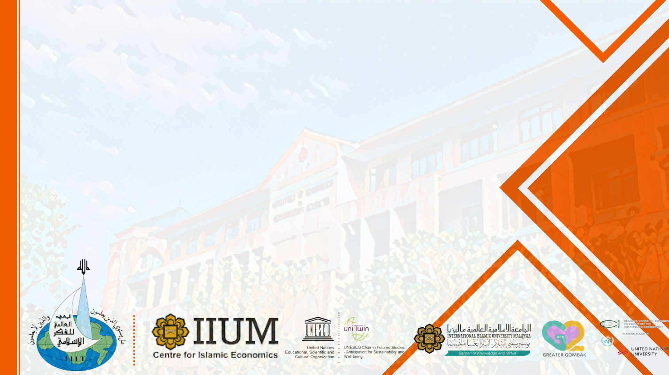
Islamic Social Finance
Assoc.Prof.Dr. Mohamed Asmy Bin Mohd Thas Thaker
Department of Economics
International Islamic University Malaysia

Slide 2
Outline
Learning Outcome
Concept of Islamic Social Finance (ISF)
Conclusion

Slide 3
Learning Outcomes
Explain the concept of Islamic Social Finance
Appreciate the dimensions of Islamic Social Finance

Slide 4
Background
Islamic Social Finance (ISF) has been instrumental in the alleviation of poverty and socio-economic development for over 1,400 years.
The term 'Islamic Social Finance' refers to modes of finance that are rooted in Islamic ethics and intended for achieving and maximizing social benefit.
The Islamic social finance sector broadly comprises of the traditional Islamic institutions based on philanthropy namely (i) Zakat, (ii) Sadaqah; (iii) Waqf; (iv) Islamic Microfinance; (v) Islamic Crowdfunding.
ISF can be a significant source of funding for the uplift of the (i) underserved communities and (ii) socio economic development activities across the globe.
The growth of ISF in many countries are significant and upward trending.

Slide 5
Zakat
Among the Pillar of Islam
Obligatory alms-giving
Zakat: a prescribed injunction to be given to certain category of needy people from the wealth of the rich ones
The most important redistribution elements in establishing social justice and social security among the Muslim community
In Quran, Allah (S.W.T) emphasised that wealth must not necessarily circulate among the wealthy ones alone but redistributed to benefit the poor and the needy.
Various types of Zakat collection by the relevant authorities to be given to the identified recipients (i.e., Zakah income, Zakah on saving, Zakah on shares and Zakah on investment

Slide 6
Sadaqah
Voluntary alms-giving/charity
Sadaqah is the charitable amount which can be paid out voluntarily in a form of donation. It is religiously encouraged. Different from zakat, there is no specific calculation provided in determining the charitable amount.
In practice, Sadaqah can be given directly to the people who are in needs. Institutionalization is not a pre-requisite in the case of Sadaqah.
In Sadaqah, the donor aims at attaining Allah’s pleasure and good reward
At the time of the Prophet (S.A.W.), the object of Sadaqah was formed of movable items such as money, food and animals or immovable properties such as land, gardens and ponds.

Slide 7
Waqf (Endowment)
Waqf, as defined a voluntary, permanent, irrevocable dedication of a portion of one’s wealth, either in cash or in kind, to Allah.
The benefits of Waqf are not restricted for the use of Muslim communities and religious activities but encompass broader scope of activities to improve and strengthen the development of social and economic conditions of a society
During Islamic history and civilization, Waqf institutions have played significant roles by providing social goods, such as education and health, public goods (roads, bridges and national security), commercial businesses, utilities (water and sanitation), religious services (building and maintenance of mosques and graveyards), aid for the poor, orphans and the needy, creating employment and support for the agricultural and industrial sectors, without imposing any costs on governments
Types of Waqf; (i) movable assets and (ii) immovable assets

Slide 8
Islamic Microfinance
Islamic Microfinance is the confluence of Islamic financing principles and the concept of financial inclusion. Primarily focus on the community's well-being and emphasizes the financial inclusion of the poverty-stricken segment of the community.
Islamic Microfinance is consistent with the broader goals of Islamic finance: they advocate for entrepreneurship and financial inclusion, and focus on developmental and social goals (to alleviate poverty)
Modes of financing in Islamic microfinance are various such as sales (Murabahah, Salam, Istisna), partnership (Musharakah, Mudarabah), leasing (Ijarah)‚ and benevolent loan (Qard Hasan).
Most of IMFIs use Murabahah or cost-plus sales contract for commercially driven loans and Qard Hasan or benevolent loan contract for poverty alleviation driven loans.

Slide 9
Islamic Crowdfunding
One of the fastest growing segments of Islamic FinTech and has proven to be an essential source of alternative finance.
Islamic crowdfunding defined as ’financing raised from a collective effort of friends, family, customers, and individual investors (or donors)-primarily online via Shariah-compliant platforms. Islamic crowdfunding MUST avoid non-shariah projects/activities.
The inherent participatory and risk-sharing elements of Islamic crowdfunding make it perfect for innovation and expansion of Islamic Finance.
There are four types of Islamic crowdfunding, donation (Sadaqah) crowdfunding, reward (Hibah) crowdfunding, equity crowdfunding and peer-to-peer financing or P2P financing.
A growing number of Sharia-compliant platforms have emerged recent years namely Ethiscrowd, which focuses on equity crowdfunding and real estate; Kapitalboost, which targets small and medium enterprises; Launchgood which is the best known and most generic reward based platform.

Slide 10
Implications of ISF
ISF has several positive and significant implications such as
Alternative source of effective financing.
It lessens the severity of economic inequality resulted from biased distribution of resources and wealth.
Protect weak and vulnerable segments of the society, in particular.
‘Vehicle’ for long term social improvements aiming for poverty alleviation and social impacts.
Considered to be ‘enabler’ for socio- economic development projects/activities.

Slide 11
Examples of ISF in Practice
Sadaqah House by Bank Islam Malaysia Berhad
EthisCrowd as first Shariah-compliant Equity Crowdfunding
Amanah Ikhtiar Malaysia, Akhuwat as Islamic Microfinance
Perbadanan Waqf Selangor, Waqaf An Nur, Yayasan Wakaf Malaysia (YWM) as Waqf institutions
GlobalSadaqah as Sadaqah crowdfunding platform

Slide 12


