Slide 1
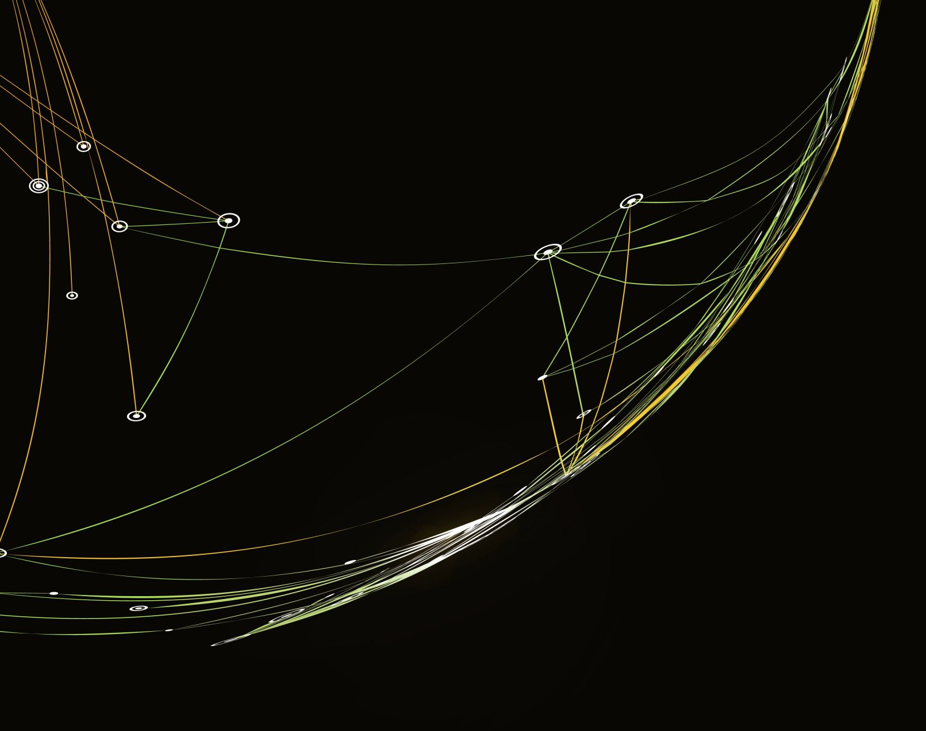
PERFORMANCE EVALUATION INDEX FOR ISLAMIC SOCIAL FINANCE INSTITUTIONS (ISFIs) BASED ON MAQASID AL-SHARIAH
Dr. Mohamed Asmy Bin Mohd Thas Thaker
Dr. Mustafa Omar Mohammed
Dr. Aslam Akbar
Prof. Dr. Jarita Duasa

Slide 2
Introduction
Most of the ISFIs performance studies focus on measuring financial performance based on the conventional aspect of performance, without focusing on the Maqāsid.
Besides, these conventional yardsticks are not adequate to measure the Maqāsid-based performance that can truly measure the identity of ISFIs.
Therefore, it is essential to examine the ISFIs with the proper tools, such as the Maqāsid al-Sharī‘ah Index (MSI), that was first developed by Mohammed, Razak, and Taib (2008).

Slide 3
Cont’d
This study aims to analyse the performance of ISFIs based on Maqāsid al-Sharī‘ah. The aim is to extend the analysis of the MSI, that is employed in the literature, to determine how far ISFIs have gone toward accomplishing Maqāsid during its operationalisation.

Slide 4
Research Questions
i. What could be an appropriate framework to measure the performance of Islamic social finance institutions particularly Zakat Institutions based on Maqasid al-Shari’ah?
ii. What are the variables that should be selected to operationalize the Maqasid components?
iii. How to prioritize the variables in each Maqasid component according to the level of importance?
iv. How can the Maqasid-based index be developed and used to measure the performance of Islamic social finance institutions particularly Zakat Institutions?

Slide 5
Research Objectives
The study is therefore, aspires to achieve the following objectives:
i. To identify an appropriate Maqasid al-Shari’ah based theoretical framework to develop a Maqasid based performance evaluation index (MPEI) for Islamic social finance institutions particularly Zakat Institutions.
ii. To identify the dimensions, elements and measures necessary to operationalize the components of Maqasid al-Shari’ah for MPEI.
iii. To confirm and validate the dimensions, elements and measures under each Maqasid component. To establish the priority of the components and their variables representing the MPEI framework.
v. To finally develop and test the MPEI to measure the performance of selected Zakat Institutions in Malaysia.

Slide 6

Literature Review
Al Ghazali Maqasid Framework
Performance measurement of Zakat institutions (see full paper)

Slide 8
Research Method
Qualitative and Quantitative approaches.
Interview, library research, annual reports

Slide 9
Stage 1 – Model Identification

Slide 10
Stage-2- Instrument Development and Selection of Variables
Sekaran’s (2013) method in operationalizing a concept (C) which is broken down into dimensions (D); and the dimensions then will be split further into several measurable items or elements (E).

Slide 11
Example

Slide 12
Stage 3- Semi-Structured Interview and Weight Assignment
The selection of the interviewees or experts was made primarily due to their expertise, specializations and experience in the areas of Shariah, economics, finance and social finance.
The MSI model developed was sent to 13 experts selected, in accordance with objectives of this research. The experts are from the Middle East and Malaysia, and are well versed in Islamic social finance.
The experts were interviewed, and they were requested to assign weights to the components and to determine whether the performance measures are acceptable. The experts were asked to assign weights to the five objectives, various elements to the respective Shariah objectives.
Besides assigning the weights, the questionnaires also solicit from the experts any comment that would enhance the understanding of Maqasid approach to the objectives of Islamic social finance and its performance measures.

Slide 13
Stage 4- Ratio identification
After the MSI model was verified and validated by the identified experts, the authors identified the following 13 ratios (R1 to R13) corresponding to each element in the model.
Disbursement for Islamic program activities / Total Zakat collection
Disbursement for Islamic education / Total Zakat collection
Disbursement for Islamic program activities / Total Zakat collection
Disbursement for financial assistance / Total Zakat collection
Disbursement for healthcare assistance / Total Zakat collection
Disbursement for debt relief assistance / Total Zakat collection
Disbursement for emergency relief assistance / Total Zakat collection
Disbursement for courses and training assistance / Total Zakat collection
Disbursement for scholarship assistance / Total Zakat collection
Disbursement for family rehabilitation assistance / Total Zakat collection
Disbursement for family related HIV/Drug program assistance / Total Zakat collection
Disbursement for house building and maintenance assistance / Total Zakat collection
Disbursement for business capital assistance / Total Zakat collection

Slide 14
Cont’d
(i) Validation of the Model and Underlying Variables
The Verification by Experts through Survey
As previously stated, questionnaires were sent to 12 experts in the areas of Islamic social finance and Islamic economics to verify the instrument developed for the study. Almost all the experts have verified the appropriateness of the instrument developed.
Assigning Weights to the Instrument
Accordingly, twelve questionnaires were received from 12 experts who assigned specific weights to the five Shariah objectives and the 13 elements.

Slide 15
Stage 5 - Index Development and Empirical Test
After completing the processes of identifying the variables and assigning the weights, an index called Maqasid Al Shariah Index (MSI) is developed using a simple mathematical equation.
The index development has fulfilled the final objective of the research. Then, the data collected from the annual reports are utilised to test the model.

Slide 16
Research Findings And Discussion

Slide 17
Computation of the Weighted Ratios

Slide 18
Relationship between
Shariah Objectives
Elements and Ratios

Slide 19
Computation of the Five Shariah Objectives

Slide 20
Computation of the Maqasid Indexes
The total overall performance measures for the five Shariah objectives for LZS constitute its individual Maqasid Index (MI).
Thus,
MSI = (SO1) + (SO2) + (SO3) + (SO4) + (SO5)

Slide 21
CONCLUSION AND RECOMMENDATION
Based on Maqasid Index as shown in Table 18, it indicates that MSI is improving in terms of its scores and reaffirms the importance of Maqasid Al Shariah in Islam and Islamic social finance such as Zakat institutions
a higher MSI index indicates that the Zakat institutions (in this case LZS) contributes to the development of religion, life, intellect, lineage and wealth of the Muslim and as a result, it promotes socio-economic justice in society and complies with its ethical identity.
The Maqasid Index can be implemented by Zakat institutions at the national and local level. It is intended that all parties in Zakat can measure and improve their Zakat performance, as well as increasing public understanding on Zakat contribution for socio-economic development of the country.
The Maqasid Index that has been developed can be evaluated annually to compare its yearly performance. Thus, the Maqasid Index can become a gauge to the underlying changes that occur in the aspects of religion, life, intellect, lineage and life, over time.

Slide 22

Challenges
Data Collection and availability = Scope of study focused narrowed down to Zakat institutions
Availability of Experts- no response after many months etc
Time constraint
Conducive environment for writing report

