Slide 1
Cleanliness and School Truancy in Kampung Tengah, Gombak
Synergised Academic Activities
Dr. Zahid Zamri
Department of Political Science, AHAS KIRKHS
zahidzamri@iium.edu.my

Slide 2
Background
7 issues were identified
Two were chosen - cleanliness and school truancy
Ethics and Politics (PSCI 4610) class
Sem 2 2021/22 - went to do the fieldwork - collected the data
Came out with reports and videos = factors and challenges contributing to the problems and proposed solutions (both from the perspective of the respondents and the students)
https://www.youtube.com/watch?v=s4g3sAYNgFQ

Slide 3
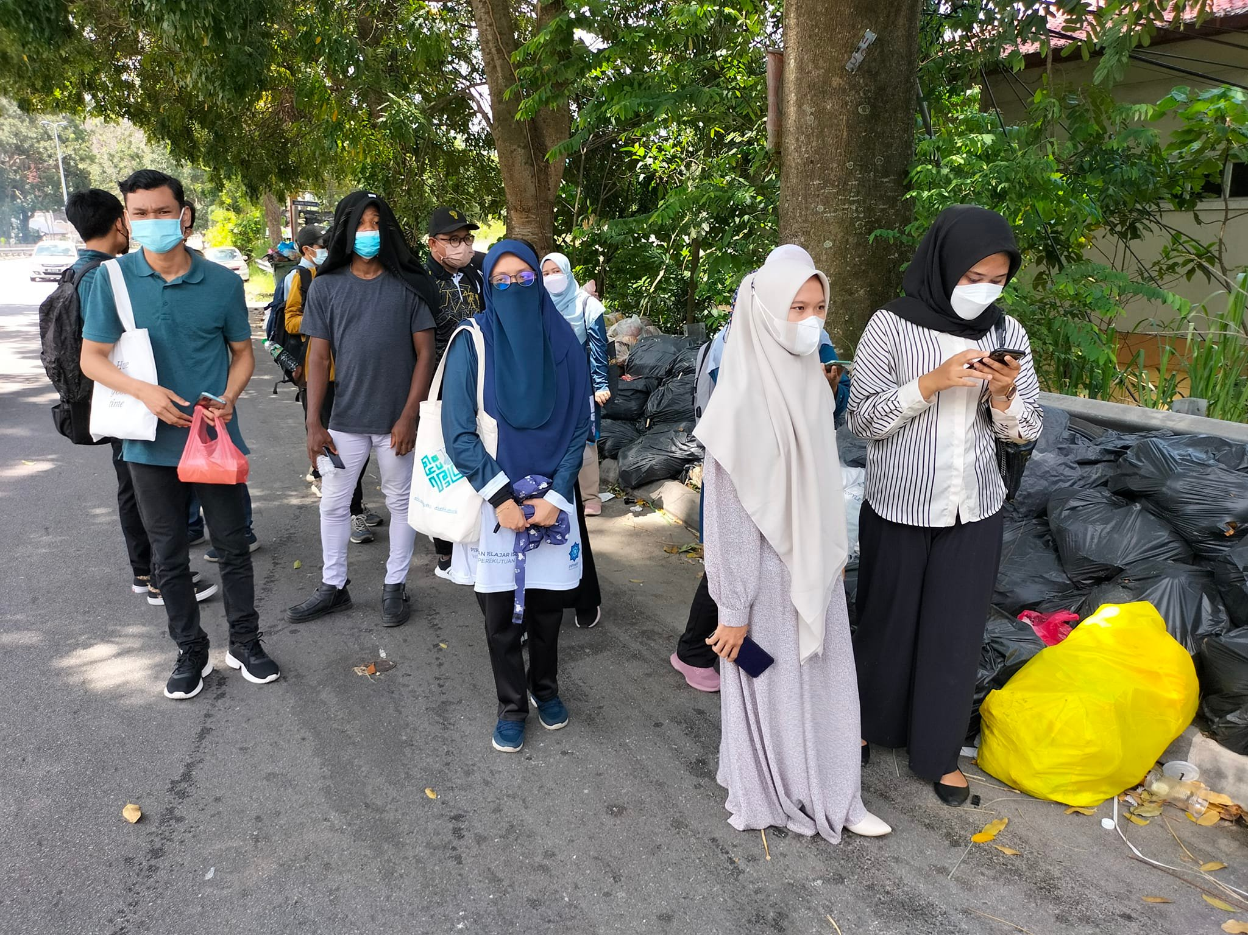
Participants
PSCI 4610 students + Secretariat of Political Science (POSSA) + JKKK (Jawatankuasa Kemajuan dan Keselamatan Kampung)

Slide 4
Data Collection

Slide 6
Intervention
1st intervention = Through the Ruhul Muhsin programme
Gombak Sejahtera Engagement Team (G-SET) + Secretariat of Usul al-Din and Comparative Religion (UDCY) + IRKHS’ Student Society (IRKHSSS) - as the Advisor
https://www.facebook.com/gombaksejahtera4u

Slide 7
Training of Trainers

Slide 8
Ruhul Muhsin@Kampung Sungai Chinchin

Slide 10
Praktikal Solat

Slide 11
Sharing Session

Slide 13
Social Media Platform

Slide 14
Next programme Ruhul Muhsin@Kampung Gombak Utara +Majlis Perbandaran Selayang

Slide 15
Next steps
Action research (come back to address the same questions with more effective ways to overcome the issues)
Publication of the research in academic journals
Translation into action (road adoption & weekend classes?)
For Kg. Tengah (next batch of PSCI 4610 students) and other villages in the Setapak’s district

