Slide 1
The Problem of ‘Historical Epistimology’ in Ottoman Malay-World Relations
Mehmet Özay
ISTAC / IIUM
19.10.2022
Asia Middle East Center (AMEC)

Slide 2
Few sources
Münşeat (16th century)
"Taht-El Raja Hakimi Alaaddin Tarafindan isdar Buyurulan Name-i Humayunun Sureti," p. 550, Mecmua-i Münşeat Feridun Bey, (991/1583), Cild-i Sani, Reprint, Rabi'ul Akhir 1274, İSAM (İslamic Research Center Library, İstanbul).
Ziya, Mehmed. (1312 / 1893/1894). Alem-i İslamiyet: Açe Tarihçesi, (Tr.:), Konstantiniyye: Malumat Kütüphanesi.
Sebilürreşad (20th century)
Tevfik Fikret. (1330 / 1912). “Hint Yolunda” (13). Hıta-i Irakiyye Umur-u Zaraiyesi Nasıl İhya ve İslah olunur?, Sebilürreşad, Mekatib, (Hindistan Muhabir-i Mahsusamızdan) -1-, Adedi: 213-34. s. 154.

Slide 3
Difficult task: Diskusi- Mau atau tidak mau?
The subject matter we will deal today is not an easy one. There are multiple dichotomies, contradictions about the presence of the Ottomans in the Indian Ocean and their relationships with the general Malay nations/states in the region.
While we are talking about the Ottomans, mostly the writers lost the orientation and are prone to lean on the aura of the superiority narration of the Ottomans. But there is also the reality that once the Ottomans were present in the adjunct regions of the Indian Ocean, they were also closing to the era of stagnation as well.

Slide 4
Today’s mistake or unfinished job of the historians
March Bloch:
“Misunderstanding of the present is the inevitable consequence of ignorance of the past.» (Macfarlane, 1).
«... It is human conciousness which is the subject matter of history.»

Slide 5
Content
The subject is between historical research and philosophy of science (Açıkgenç, 2018)
‘Foundation’ problem in study of history
In the case of the Ottoman and the general Malay World
Uzunçarşılı-İnalcık-Özbaran-Gökyay-Kafesoğlu
The theme of ‘Ottoman maritime power’
General books of history of Islam (general or detailed information about the Archipelago (Indian Ocean)
Domestic ideological disputes (National/Institutional)
Defending «safety zones» (Individual)
Need integration with novel/alternative thoughts (Özbaran&Others)

Slide 6
knowledge production via study of history
Concepts «borrowed» from the discussion of history of philosophical epistemology
«object of knowledge based on historical conditions»
historical research
i)on socio-historical phenomena
ii)philosophy of science
Epistemology (historical epistemology)
Geographical conciousness; political (economic) awareness; foundation of knowledge; knowledge activities etc. (Açıkgenç, 2018)

Slide 7
Fundamental problem (need for sound epistemology in history studies)
«consistency problem»
«...center-periphery perspective that still persists among scholars working on this topic...»
«Superiority/inferiority...» (Özay, 2022)
Universal sovereignty

Slide 8
Fundamental problem: narration&fictionalization
The only point where this type of historiography, called the narration going back to Herodotus (d. 425 BC), differed from the fairy tale, was the mention of time and place in the events described...
“... The lack of narrative historiography has created the method called Instructive (Pragmatic) historiography.

Slide 9
History studies: An overview
Chronologic & narrative forms (back to Heredot d. 425 BC)
... Taberi (d. 932), İbnü’l Kathir (d. 1231) etc. are the representatives / members of this school.
... Mesudi (d. 997) and İbn Miskeveyh (d. 1029) tried to attempt to overcome the obstacles of this method.
Philosopher of history/sociologist (or probably better to call him a philosopher of history (d. 1406) could not be escaped from this trap of narrative style (Kutlu, 2004: 53).

Slide 10
Reactions of some Turkish social scientists to the study of history

Slide 11
History studies in Turkey
«... In the first 15-20 years of the Republic, many works were written within the framework of didactic historiography.
However, it is certain that the didactic method has some disadvantages in terms of historiography.
It leads to an unnecessary contemplation, especially to a certain chauvinism in national history bets.» (Kafesoğlu, 2014: 238).

Slide 12
Understanding of history and historiography
«… in history writings there have been no consistent efforts to arrive truth and consciousness in the historical stages/periods...
… 'imagination' is encountered rather than 'truth', and a kind of 'literature’ emerges.” (Kadri, 2018: 77)

Slide 13
Continues...
«… why our histories are often written incorrectly or incompletely and we are compelled to refer to foreign sources even about the most recent events...»
«... It is because our individuals, who have witnessed historical developments, even themselves have been actors of these events, are not in the habit of keeping their memories day by day, noting the cases and then collecting them and publishing them.“ (Güventürk, 1962: 3)

Slide 14
Continues...
«... no significant university department or research center within present-day Turkey has been established to look into regions where the Ottomans had had enduring relationships in the past.» (Özbaran, 2001: 65).

Slide 15
Traps in knowledge production
«Until recently, Ottoman–Malay relations have been viewed by Turkish historians as an insignificant topic and approached from the lenses of a domestic ideological fight between the laic/secular and conservative factions (Faruqi, 1992, 3, 12).

Slide 16
«Safety Zone»
«... an indelible enduring intrinsic peculiarity of these academic circles must be present for them not to leave their safety zones...»
-serving for political purposes & gaining a short-term fame in the eyes of the latter.
-having a popularity in mainstream media (Gönül Coğrayfası)

Slide 17
How did the Ottomans perceive the Malay world & produce knowledge?

Slide 18
The issue of «Universal sovereignty»
“... Ottoman claims to universal sovereignty and the simultaneous rise of geographical conciousness among the 16th century Ottoman literati, politicians, and image makers...»
The practical reason of this issue emerged aligned with the power competition in the Mediterranean»
The Ottoman navy won the war against the Venice (allied with he Spanish monarchy) in 1538 which was the result of rivalvry for universal hegemony» (Libby, 1978: 103).

Slide 19
Universalization issue
Ali Ekber Khitayi’s work... (1516)
This statement is related to the work of Khitayi’s work upon China produced in 1516. The same year (1517) the Ottomans expanded its territory in the Southern region till Hijaz, had a border to the Indian Ocean. Although the China entered in the radar of the Ottoman bureuracratic elite, we could not see any crucial works upon the Indian Ocean.

Slide 20
The issue of the Ottomans and ‘geographical conciousness’
The question is what place the Indian Ocean occupied in the Ottoman political mind.
«... no established sustainable institutionalized networks on an eco-political basis.»

Slide 21
Geographical Conciousness
A crucial question needs to be asked whether it is possible or not without any conciousness of the wider seaways such as the Indian Ocean during the 16th century onwards (at least aligned with the expansioning period of the Western European maritime nations)
Any action in the form of «geographical society»

Slide 22
Geographical borders&conciousness
«... Geographical works redefined the boundaries of the inhabited world in the early modern period... (Emiralioglu, 2012: 163).
This is related to geographical conciousness. With the relevancy of the Acehnese envoys send by the Aceh court to Istanbul (1562?-1567?) (Azra, 1999: 53) is no doubt an implicit venture to open a new geographical vision for the Ottoman bureuacracy.

Slide 23
Political conciousness and preparedness
Bloch: «... It is human conciousness which is the subject matter of history.»
For states, conciousness is inevitable phenomenon. Geographical conciousness is the initial stage of the network/connectivity/relationship.

Slide 24
Classical works and enrichment of Ottoman geography knowledge!
What the Ottoman bureaucratic elite and/or intellectuals knew about he following works before initiation of their maritime engagement to the Indian Ocean:
Marco Polo, (1295)
Abu Abdullah Muhammad Ibn Batuta (1344-45)
Ludovico di Varthema (1503-08)
Odoric of Pardonone (1320-30)
Athanasius Nikitin (1466-1472)

Slide 25
Dichomoty: military power and/or commercial interest
“While the inadequacy of commercial activities in the shadow of the navy constitutes an issue that historians mostly accept and agree on, it casts doubt on the idea that the Ottomans created a naval empire.” (Özbaran 2007: 49).

Slide 26
General books of history of Islam and the Archipelago&Indian Ocean
A fundamental statement:
«The Ottoman State’s engagement with littoral states in the Indian Ocean has been a subject of lesser discussion in general Ottoman history»
Dynamic relations but ‘Dissonance’:
«... the dynamic relationship between the Ottoman state and Malay polities while noting the dissonance that occurred in the process.»

Slide 27
“.... We have very limited information on the number of the Ottoman Empire's naval power in the Indian Ocean and the salaries they received. The mevacib (stipends) and accounting books preserved both in Topkapı Palace and in the BOA in Istanbul contain some illuminating information about the permanent naval power of the Ottomans on the ocean line (Özbaran, 2013: 274).

Slide 28
The year 1600 and Ottoman maritime power in Basra
... the number of troops in Basra in 1600.
734 volunteers (not experienced in shipping)
610 merdans,
429 azeb and other officials in the castles.
These numbers reflect how weak the Ottomans were when compared to actual naval forces on the Persian Gulf. A comparison with land forces or, for example, naval power in the Red Sea will show the Ottomans' deficit in Ocean navigation.

Slide 29
Continues...
The second table, which reflects the salaries of permanent naval forces, includes annual expenditures, it is clear (Özbaran, 2013: 274-5). how limited they are compared to ground troops

Slide 30
Problem:
The established Ottoman maritime in the Mediterranean is suggested as a measure to resonate its presence in the Red Sea (say, Indian Ocean). / Not reflecting much of the reality
The maritime issues including human resources, material infrastructure, climate and sea characteristics (moonsoon etc.) are totally distinct between these two seaways.

Slide 31
Imbalances
«... to redress this imbalance by re-evaluating the time period»
Imbalance occurs in searching the sources / political mindednes /religious attachment etc. in the context of Malay polities (societies)
Historians who have utilized these sources have been observed to tend to evaluate these superficially.
They aggrandize the mighty power of the Ottomans and downplay the agency of the Malay polities

Slide 32
A new way of study (but old concerns!)
epistemological perspective:
«normative questions to do with the nature of knowledge»
Problem:
«‘historical epistemology’, has begun to explore the means by which, and the historical conditions under which, structures of knowledge emerge and take shape over time.»

Slide 33
Critique
Critique of reasonability of Turkish academia in their knowledge production
What we mean by critique: the word "critique." Instead of referring to the practice of passing harsh judgment, "critique" here relates to the practice of evaluating, understanding and explaining complex problems (Arkoun)

Slide 34
Some Suggestions or Principals:
i)Comparison
ii)Multidisciplinary (“Working on the borders of the disciplines”)
iii)Assemble materials then iv) generalize and v) organize
-each historical problem there is a unique type of document with a specific sort of use.
-the deeper the research, the more the light of the evidence must converge from sources of many different kinds,
-to neglect to organize rationally raw material is only to deny history itself’ (Bloch) (Macfarlane, 2)

Slide 35
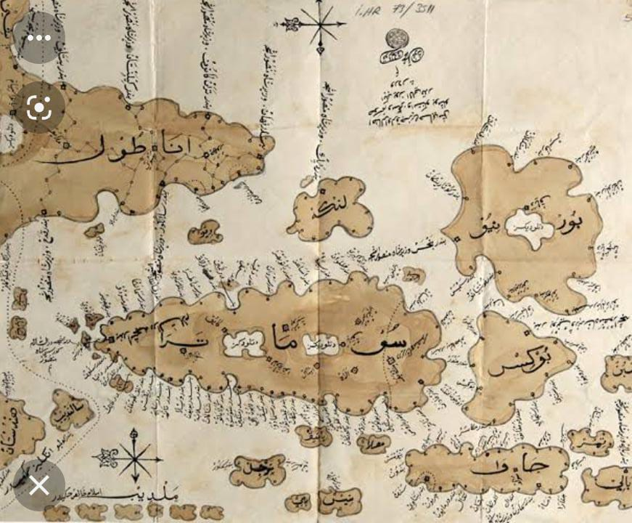
Thank You!

