Slide 1
Roundtable | Implementing COIL Virtual Exchange in the Classroom
2nd September 2022
SHENANDOAH UNIVERSITY, WINCHESTER, VIRGINIA, USA
Prepared by,
Asst.Prof. Dr. Nor Zainiyah Norita Mokhtar

Slide 3
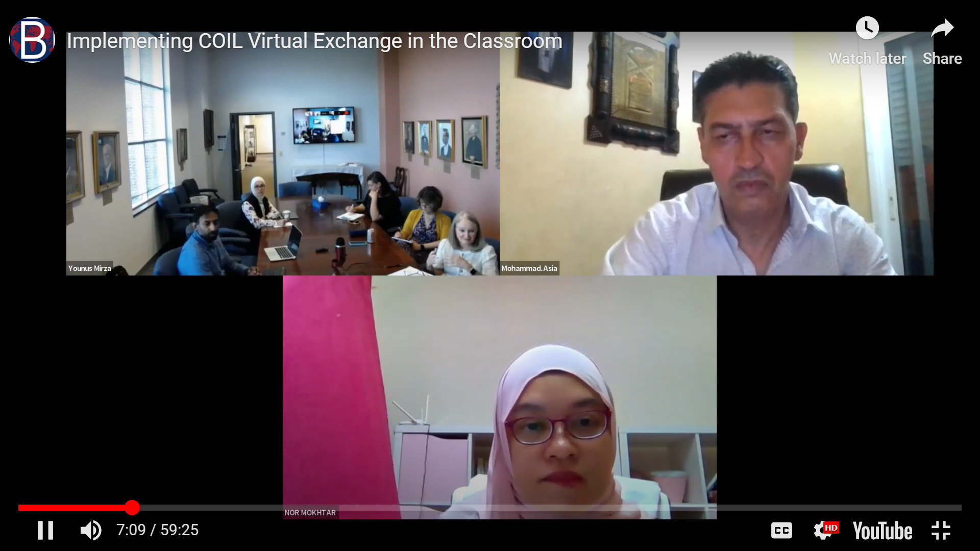

Slide 6
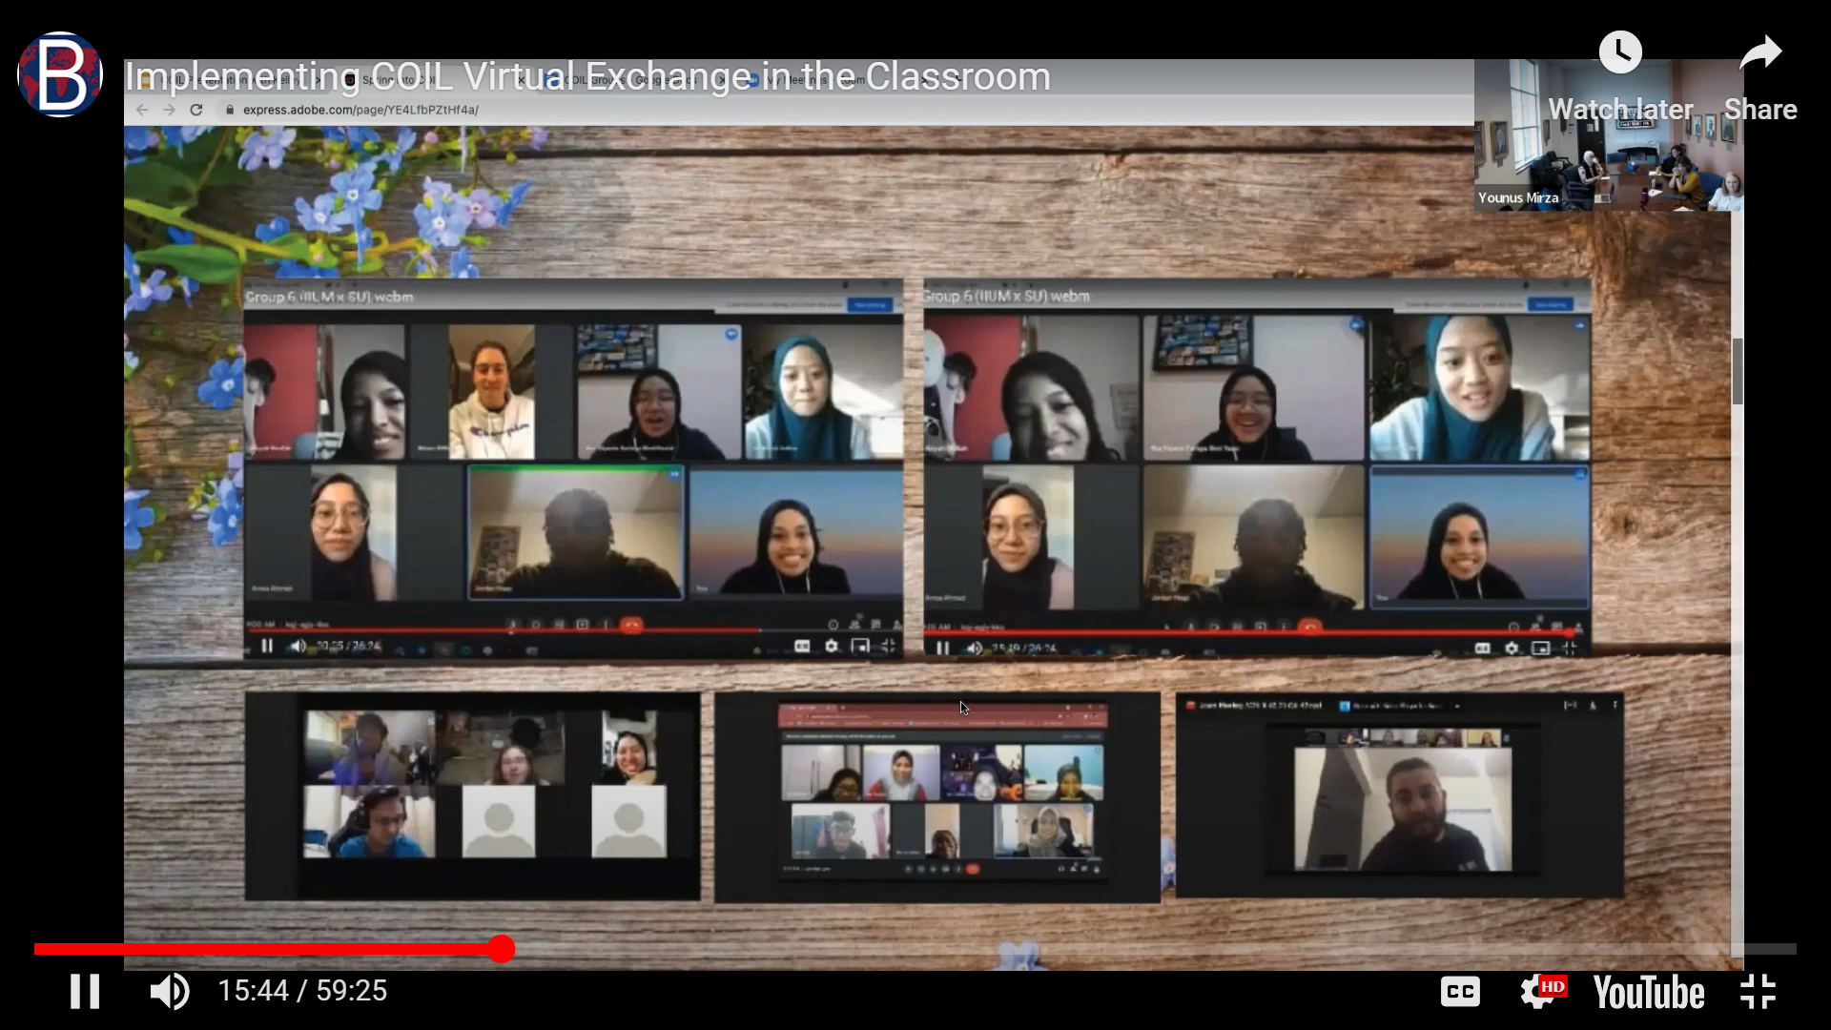

Slide 15
Jazakallah Khair and Thank you

