Slide 1
SEMANTICS
POLITENESS : CULTURE INTELLIGENCE IN MASCULINE AND FEMININE DISCOURSE
BY
ASST. PROF. DR. NOR ZAINIYAH NORITA MOKHTAR

Slide 2
OVERVIEW
Politeness
Masculinity & Femininity
Politeness as practiced by male and female participants
Culture Intelligence in masculine and feminine discourse
Conclusion

Slide 3
Politeness
A framework formulated by Brown and Levinson (1987) consisting of several strategies to preserve the notion of face
Face can be categorized into 2 types
Positive face – consistent self image or personality related to the idea of being appreciated, acknowledge and approved of by others
Negative face – refers to privileges and the rights to not be hindered by actions and obligations to others.

Slide 4
Masculinity & Femininity
4th dimension in Hofstede’s National Cultural Dimension (2001)
Masculinity - “a preference in society for achievement, heroism, assertiveness and material rewards for success.”
Femininity - “a preference for cooperation, modesty, caring for the weak and quality of life.”
Women in the respective societies tend to display different values. In feminine societies, they share modest and caring views equally with men.
In more masculine societies, women are more emphatic and competitive, but notably less emphatic than the men.

Slide 5
Observation on the practices by male and female participants

Slide 6
4. Culture Intelligence in Masculine and Feminine discourse

Slide 7
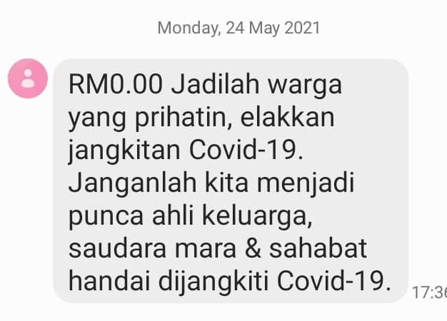
What is the ideology shared within these contexts?

Slide 8
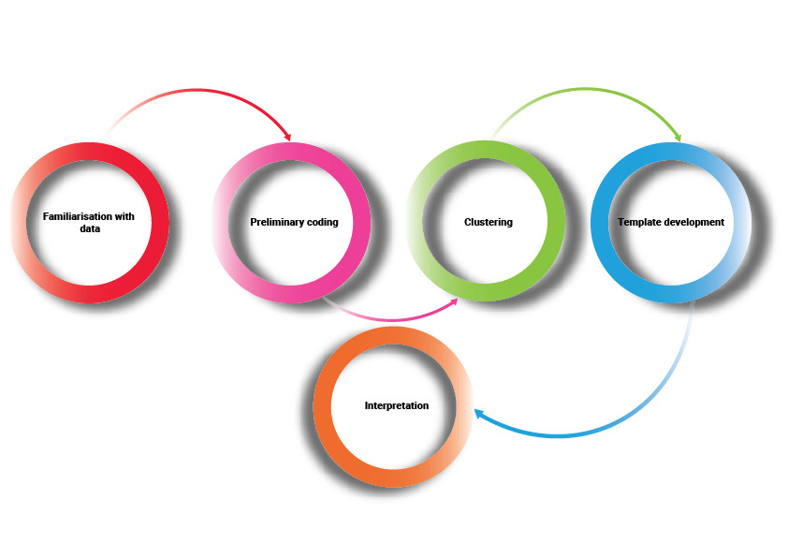
Thematic Analysis
Themes are patterns across data sets that are important to the description's of a phenomenon and are associated to a specific research question
The themes than become categories for analysis
Thematic analysis is performed through the process of coding in 6 phases to create established, meaningful patterns.

Slide 9
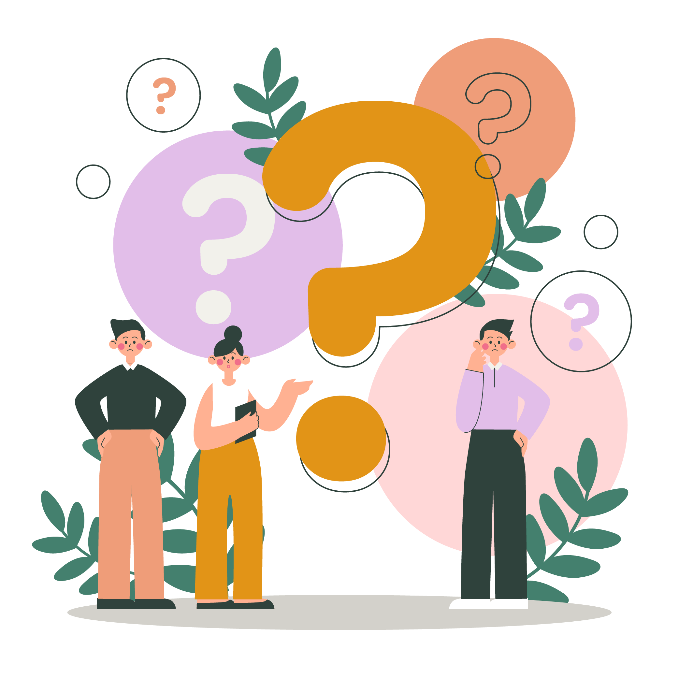
An example to consider:

Slide 10
To be continued…
Thank you for listening
Jazakallah Khair

