Slide 1
Integrating Culturally Responsive
Teaching in PBL Classroom
6th of July 2022
Auditorium SJKC Chung Hwa 3
Prepared by,
Asst.Prof. Dr. Nor Zainiyah Norita Mokhtar

Slide 2

We live in a culturally diverse world

Slide 3
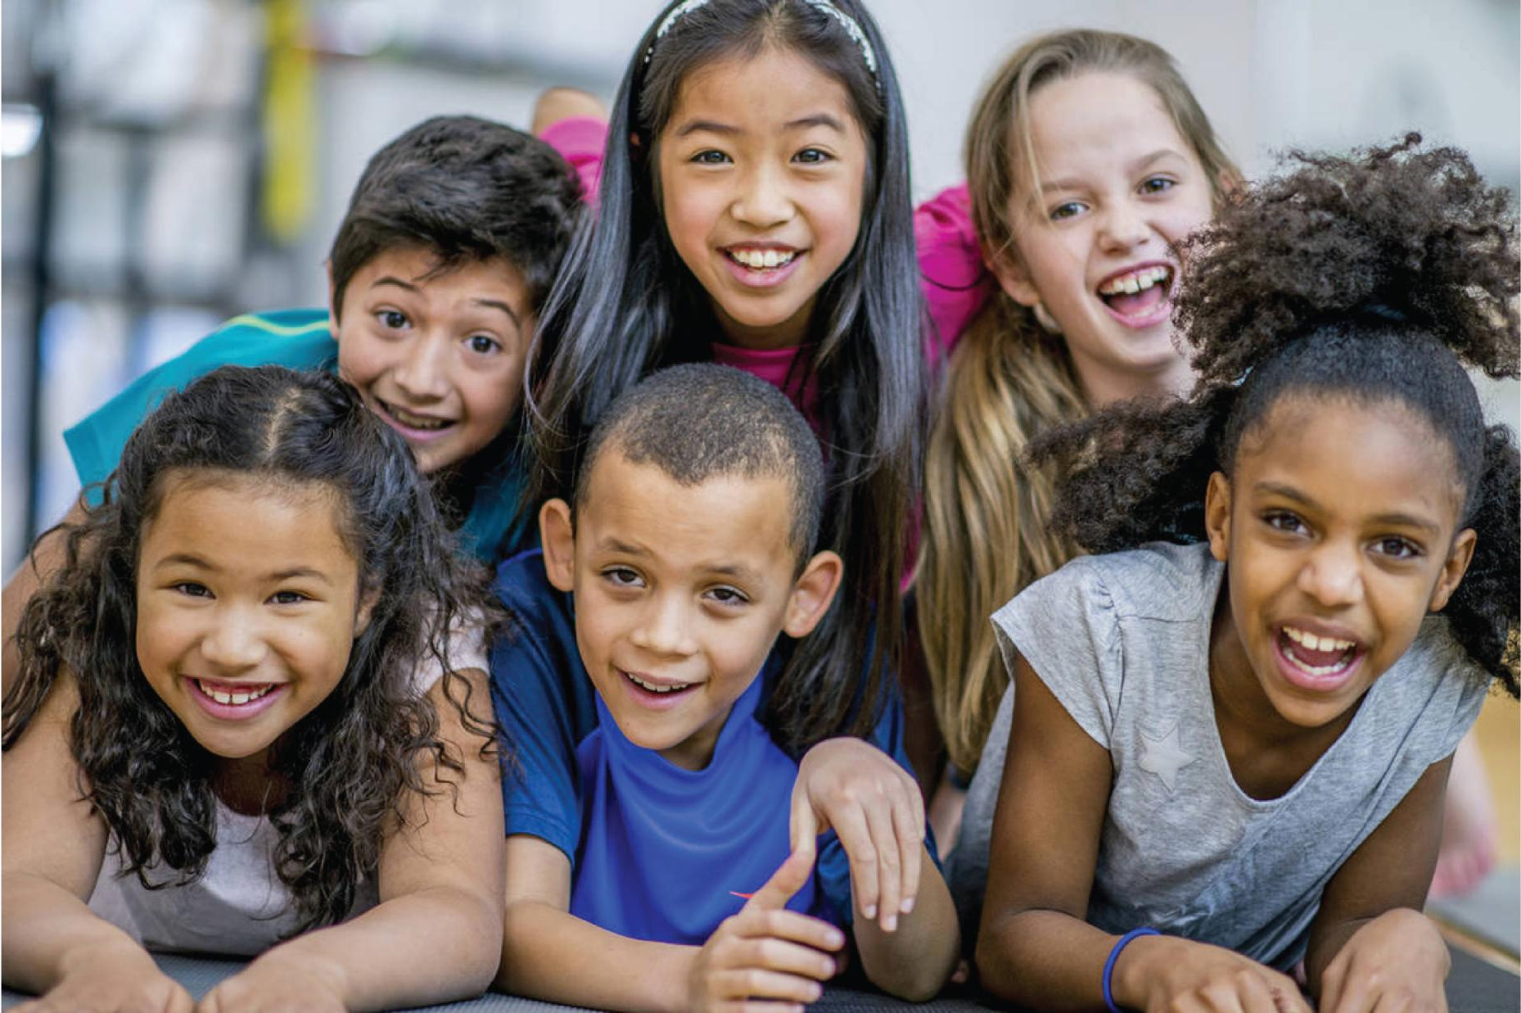
And a culturally diverse country...

Slide 4

And we work in a culturally diverse community

Slide 5

How do we teach our children in a culturally sensitive environment?

Slide 6
What is Culturally Responsive Teaching
“It is an approach that empowers students intellectually, socially, emotionally, and politically by using cultural referents to impart knowledge, skills, and attitudes”
-Gloria Ladson-Billings

Slide 7
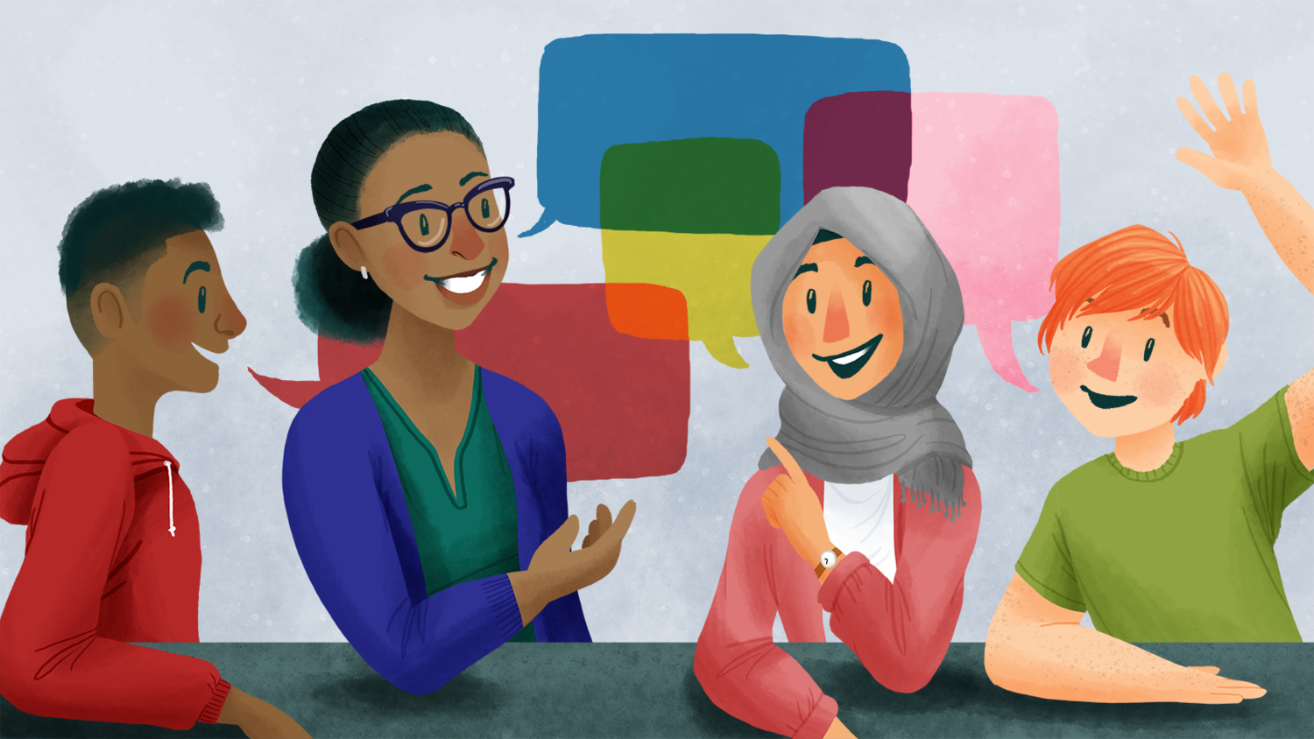
How do we become culturally sensitive teachers?
Acknowledge the legitimacy of the cultural heritages of different ethnic groups, both as legacies that affect students dispositions, attitudes, and approaches to learning and as worthy content to be taught in the formal curriculum.

Slide 8
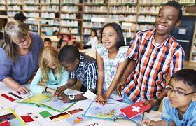
How do we become culturally sensitive teachers?
Communication of High Expectations:
There are consistent messages, from both the
teacher and the whole school, that students will
succeed, based upon genuine respect for students
and belief in students’ capability.

Slide 9
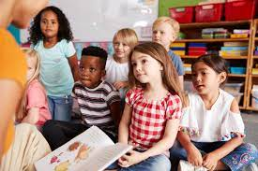

How do we become culturally sensitive teachers?
Use a wide variety of instructive strategies
that are connected to different learning styles.

Slide 10
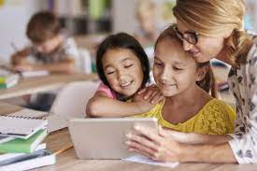
How do we become culturally
sensitive teachers?
Instruction is organized around low -
pressure, student - controlled learning
groups that can assist in the development
of academic language.

Slide 11

”As the soil, however rich it may be, cannot be
productive without cultivation, so the mind
without culture never produce good fruit.”
- Unknown

Slide 12

Teacher as Facilitator
Within an active teaching environment,
the teacher’s role is one guide,
mediator, and knowledgeable consultant,
as well as instructing with a smile.

Slide 13

Teacher as Facilitator
Employ active teaching methods.
instruction is designed to promote student
engagement by requiring that student play an
active role in crafting curriculum and developing
learning activities.

Slide 14
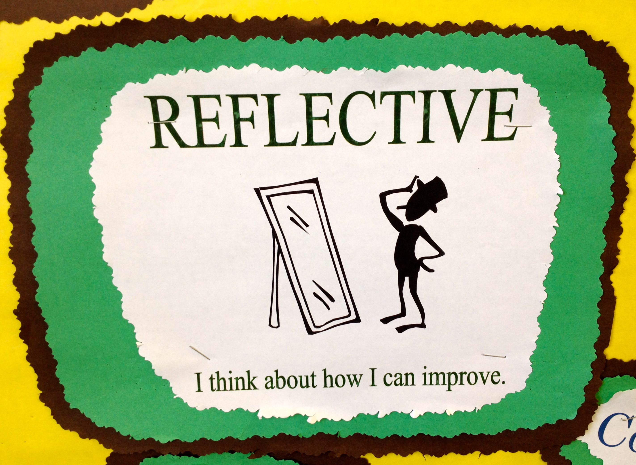
Reflective Teaching
Reflective teachers are alert to their own
preconceptions and open to new ways of
thinking.
Uncover your own beliefs.

Slide 15
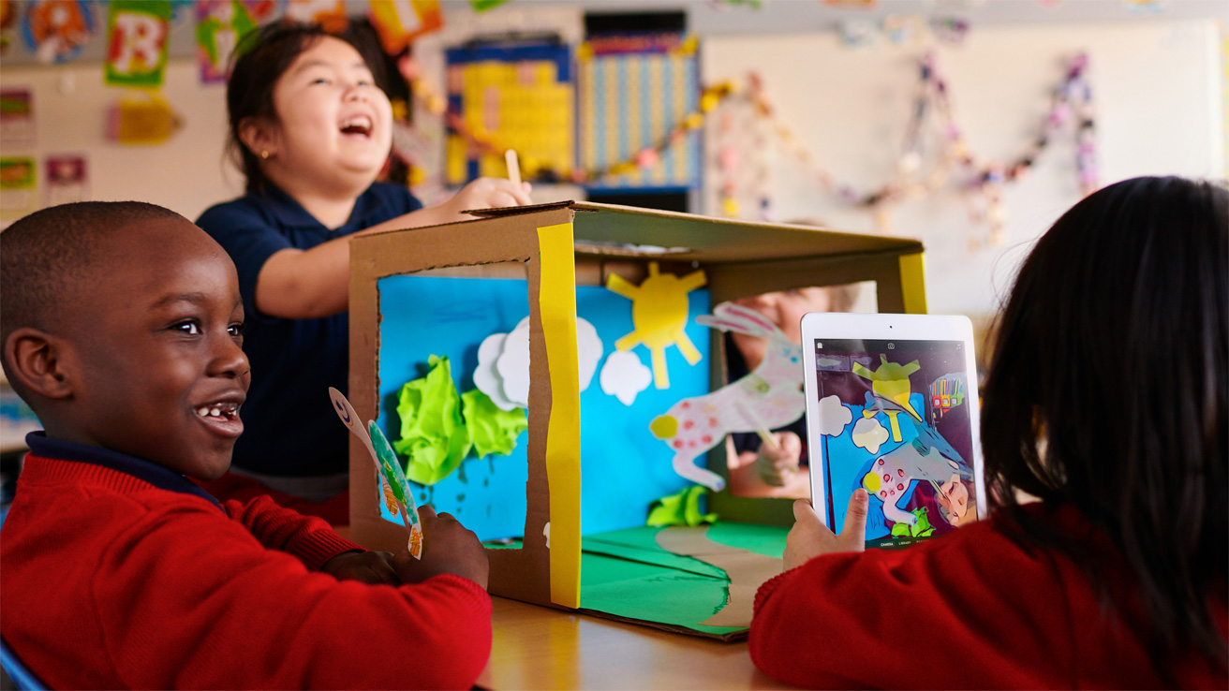
Reshaping the Curriculum
A reshaped curriculum is culturally
background of students.
Teacher should know the cultural
heritage of their students and include
references in the curriculum.
A culturally Responsive Curriculum
does not rely on one-time activities
“add-on” units or “sprinkling” the
traditional curriculum with a few minority
individuals.

Slide 16

Reshaping the Curriculum
A Culturally Responsive Curriculum is authentic,
child centered, and connected to the child’s real life.
It employs materials from the child’s culture and
history to illustrate principles and concepts.

Slide 17

Reshaping the Curriculum
Build Bridges of meaningfulness between home and
school experiences, between curriculum and social reality.

Slide 18

Reshaping the Curriculum
Incoporate multicultural information, resources and materials in all
subjects routinely taught in schools.

Slide 19
Reshaping the Curriculum
Students are given the opportunity to control some portion
of the lesson, providing teachers with insight into the ways
that speech and negotiation are used in the home and community.

Slide 20
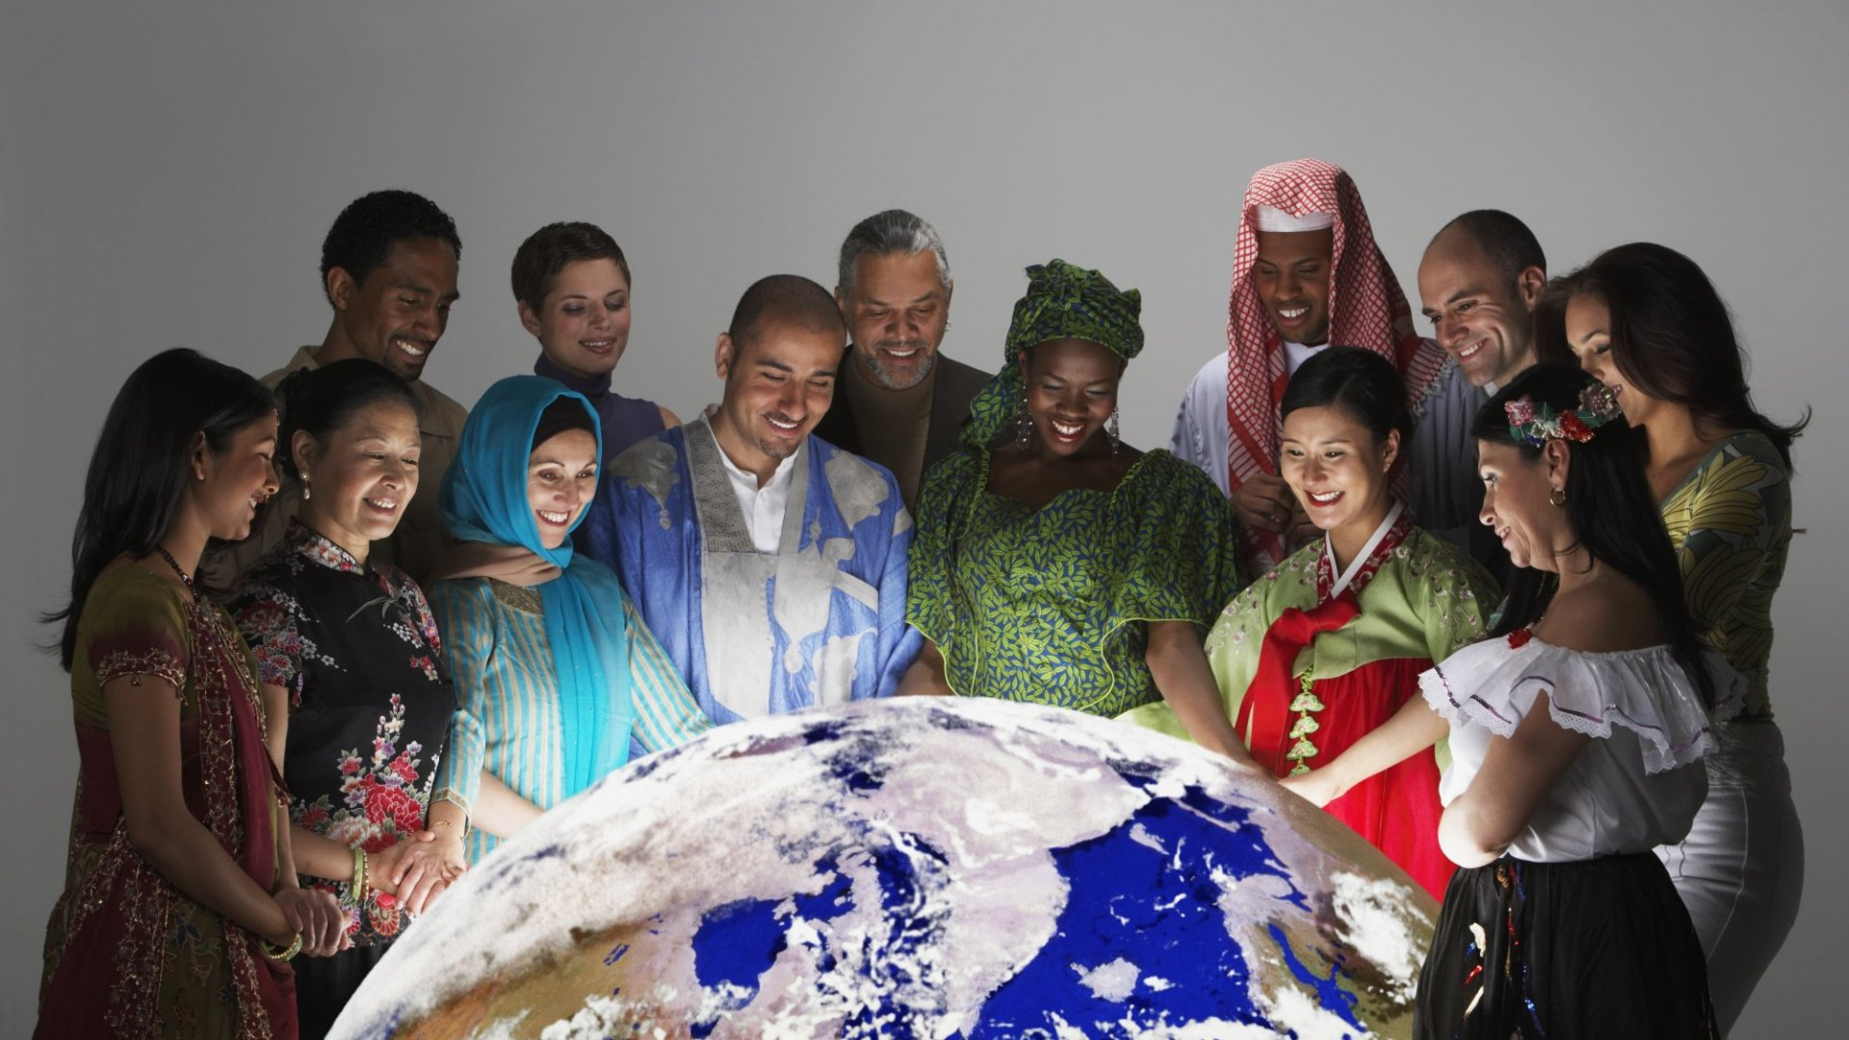
“ Culture is the sum of all the forms of art. of
love, and of thought, which, in the course of
centuries, enabled man to be less enslaved”
- Andre Malraux

Slide 21
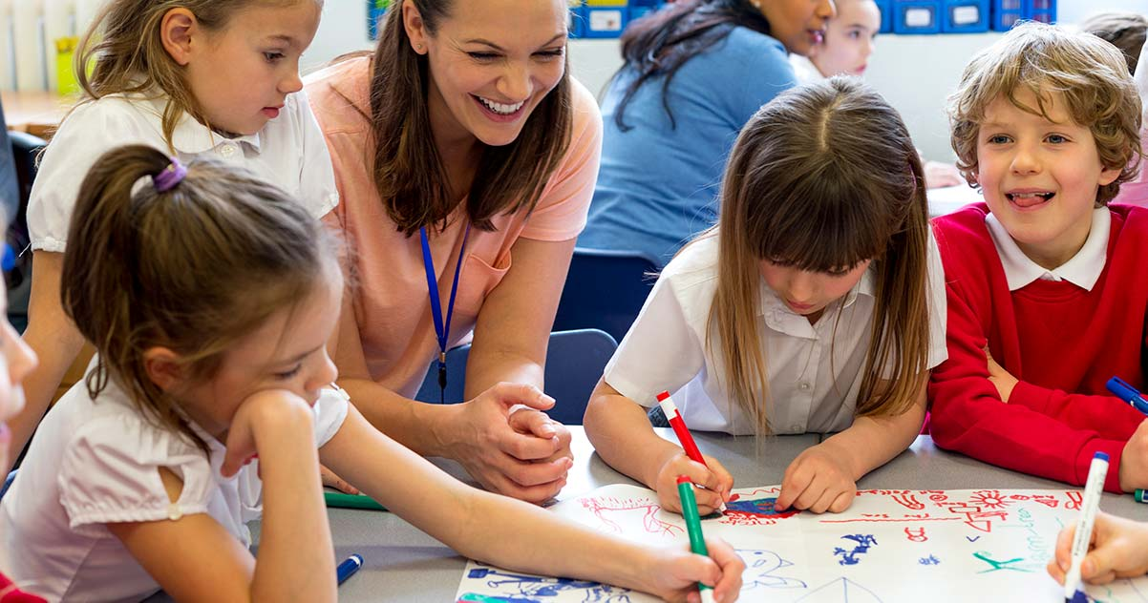
Classroom Activities
Activites to increase cultural sensitivity:
Autobiographical writing
assignments
Oral presentations on
students’ native countries
Discussing current events
from a multicutural
viewpoint.

Slide 22
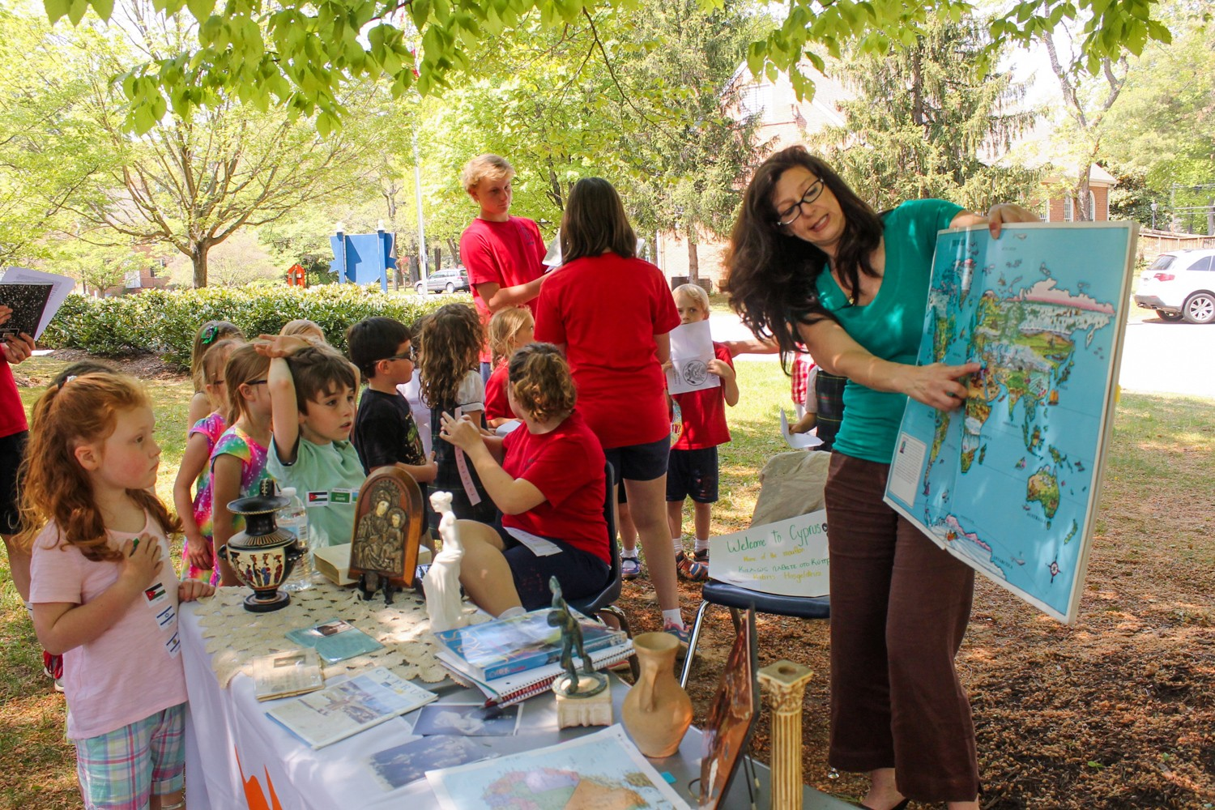
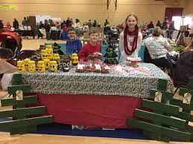
Classroom Activities
More activities to stimulate cultural sensitivity:
Organizing ESL students to provide peer tutoring to other
students studying their native language.
Organizing a cultural bazaar to showcase student cultures with the
larger community,
Participating in a school talent show to share culturally unique
skills and dances.

Slide 23
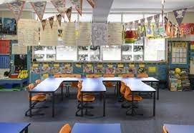
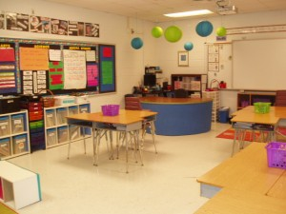
Classroom Appearance
Classrooms should
be filled with
photographs and
artwork
representing the
wide range of
humanity and daily
life.

Slide 24
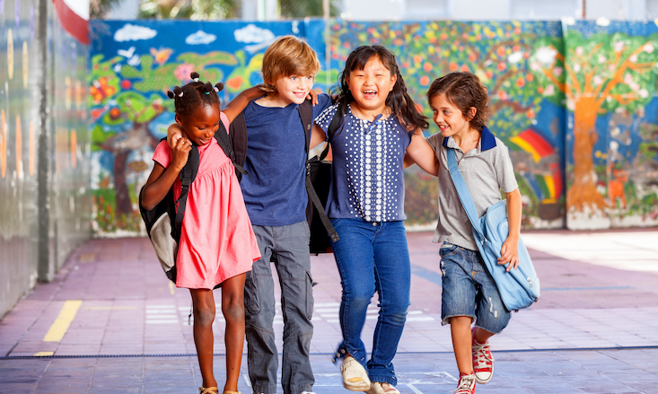
“Be what you is, not what you ain’t. ‘ Cause if you ain’t what you is, you is what you ain’t”
- Luther D. Price

Slide 25
Foster a Sense of Belonging
There is a need for an ongoing dialogue with students, parents and community members on issues important to them, along with the inclusion of these individuals and issues in classroom curriculum and activities

Slide 26

Foster a Sense of Belonging
For new students
or students who seem isolated,
a teahcer can assign a buddy
who wil help them to feel at
home.

Slide 27

Foster a Sense of Belonging
“ Each friend represents a world in us,
a world possibly not born until they arrive.
and it is only by this meeting that a new world
is born.” - Anais Nin

Slide 28

Sharing Cultures
Teach students to know and praise their own
and other’s cultural heritage

Slide 29

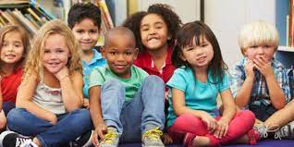
Sharing Cultures
Multiculturally sensitive education does not solely prescribe to mainstream
ways of knowing. Teachers make authentic knowledge about diferrent ethnic
groups accessible to students.
For example, the verbal creativity and storytelling that is unique to some African
Americans in informal Social interactions is acknowledged as a gift and used to
teach writing skills.

Slide 30

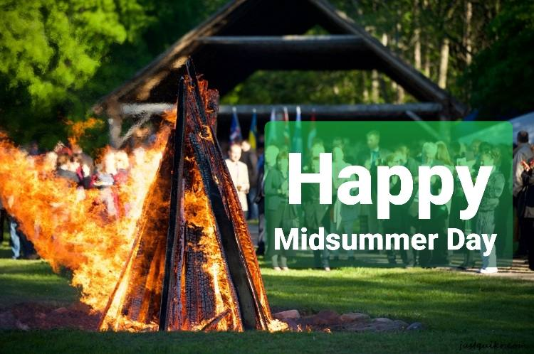


Sharing Cultures
Eid, Chinese New Year, Deepavali, Christmas, Kwanzaa, Easter, Yom Kippur, Passover,
Hanukah, St. Lucia Day, Songkran,
Aboakyere, Midsummer Day, Obon, Basanth New Year and etc.
There are many holidays in the world. In a culturally responsive
curriculum students will learn about many different holidays and
traditions.

Slide 31

Sharing Cultures
Culturally responsive teaching enables students
to be better human beings and more successful
learners.

Slide 32

Culturally Responsive Teaching is Empowering
”Give a man a fish and he eats
today; teach a man to fish and
he eats for the rest of his life.”
- Unknown

Slide 33
Culturally Responsive Teaching is Transformative
It means respecting the cultures and
experiences of various groups and
then uses these as resources for
teaching and learning.
It appreciates the existing strengths
and accomplishments of all students
and develops them further in instruction.

Slide 34
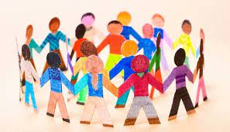
Culturally Responsive Teaching is Transformative
Culturally sensitive education
empowers and transforms students
by helping them to develop the knowledge,
skills and values needed to become social
critics who can make reflective decisions
and implement their decisions in effective
personal, social, political and economic
action.

Slide 35

Culturally Responsive Teaching is Transformative
Multicutural education guides students in
understanding that no single version of “truth”
is total and permanent.

Slide 36

Culturally Responsive Teaching is Transformative
The validation, information and pride generated by
multiculturally sensitive education are psychology
and intellectually liberating.

Slide 37
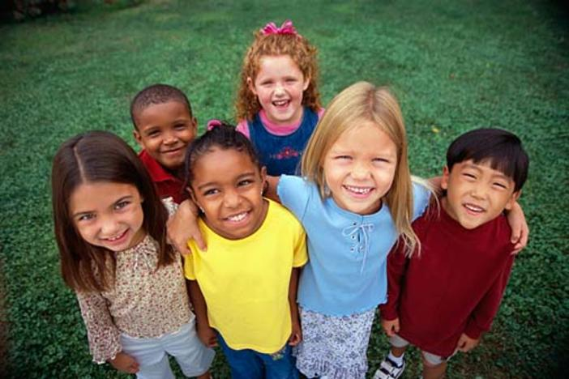
“There are only two lasting bequest we can hope to give our children. One of these roots, the other, wings.”
-Hodding Carter

Slide 38
Can-do approach
CEFR/CFR

Slide 39
Projects Completed
https://sites.google.com/iium.edu.my/asst-prof-dr-nor-zainiyah-nori/home
https://drive.google.com/drive/folders/1K75kZOXXor46iESZn5FOuu_r4ZescMkc
https://drive.google.com/drive/folders/1V8GH7rUqrCP9skwaSrubeB1Qy1mXPU4d?usp=sharing

Slide 40
Jazakallah Khair and
Thank you

