Slide 1
Evolving Visions of Paradise: How Mahathir Mohamad used Islam
Syaza Shukri

Slide 2
AGENDA
Introduction​
Early Beginnings and Malay Nationalist
​Islamizing Bureaucracy
Neoliberal Authoritarianism and Muslim Autonomy
​Islamizing Foreign Policy
​Anti-Elite Populist and Muslim Democrat

Slide 3
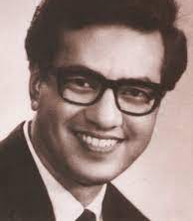
Introduction
Mahathir created a political discourse of a hegemonic “people” that fits into Laclau’s (2005) definition of populism.
From his time as a backbencher in Parliament, Mahathir has emphasised ethnic Malays to be “the people” in Malaysia that needs government protection and support.
Since Malays are legally Muslims, there is a conflation in defining “the people” in Malaysia.
Throughout his political career extending over five decades, Mahathir appeared to have shifted his priority and rhetoric from defending Malay rights to Muslim rights, and finally to universal values of justice and democracy.
However, some has argued that beneath the change in rhetoric is the same man that is ultimately an able orator that has a populist appeal through his sheer charisma and political manoeuvrings.

Slide 4
Early Beginnings and Malay Nationalist

Slide 5
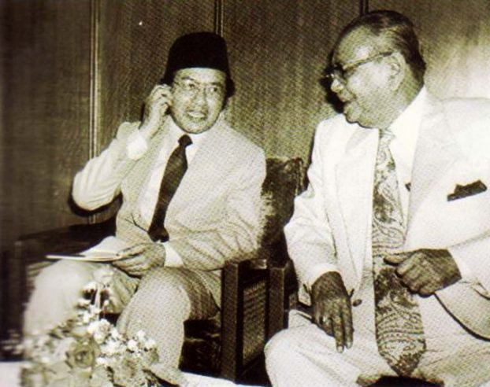
“…long ago, when I was a child, I saw a lot of Chinese and Indians coming to Malaya, and I realise that they came here because we Malays did not want to do certain work. So, they came here to do the work” (personal communication, 18 May 2021)
Mahathir maintained his position as a staunch supporter of Malay rights and disagreed with Tunku Abdul Rahman’s convivial attitude towards Chinese tycoons from whom UMNO depended for political funds in the early years.
Upon his return to parliament in 1974 following 1969, Mahathir was appointed Education Minister
English-medium schools in Malaysia were transitioned into Malay-medium schools, but Chinese and Tamil vernacular schools were kept open
Islamic Education, Moral, and Civic, were added to the school curriculum
Islamic Education a required subject in public examinations
AUKU

Slide 6
ISLAMIZING BUREAUCRACY

Slide 7
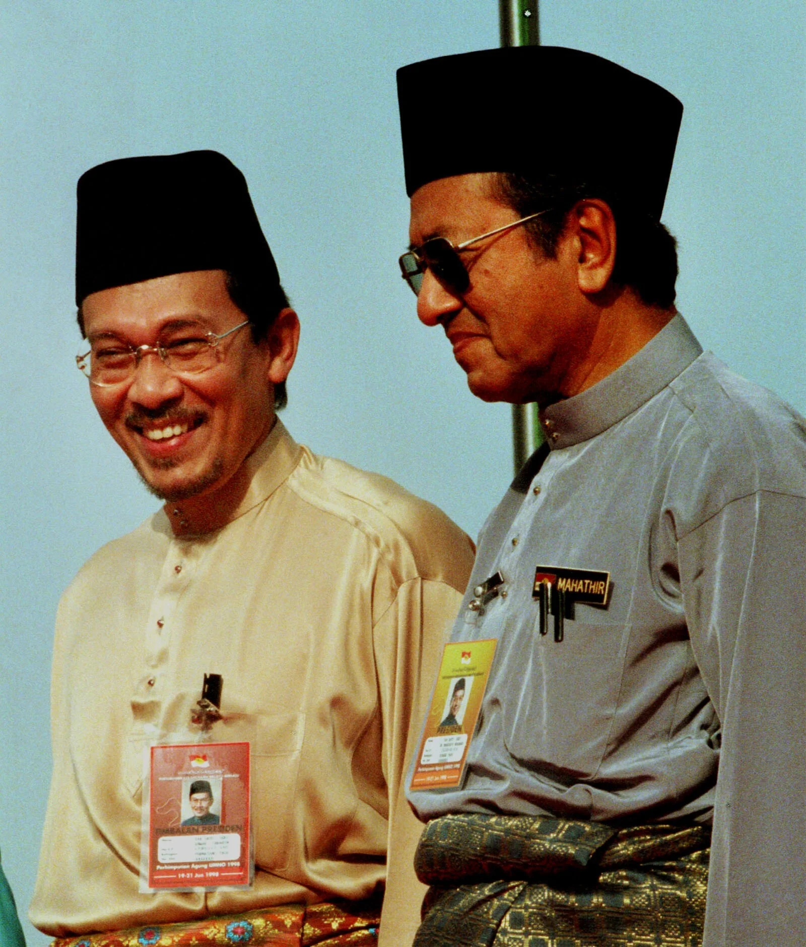
As an ethno-religious leader who understands the people, Mahathir used fearmongering as a tactic to drive votes away from PAS by labelling PAS’ supporters as ‘fundamentalists’ and even ‘deviationists’
UMNO’s version of Islam is promoted as the only correct version of Islam to be practiced in Malaysia, which is Sunni Islam based on the Shafiee madhab
One of the steps taken by Mahathir was to co-opt Anwar Ibrahim
"The Concept of Development in Islam" was later adopted by the government, including the creation of Bank Islam in 1983
Establishment of the Islamic Teachers’ College in 1980 and the International Islamic University in 1983
The ‘Inculcation of Islamic Values in Administration’
The official establishment of JAKIM in 1997
On February 18, 1992, the Institute of Islamic Understanding Malaysia (IKIM) was founded with the purpose of revealing a government-approved understanding of Islam
In 1988, the Malaysian parliament passed constitutional amendments that resulted in the elevated status of sharia courts on par with civil courts

Slide 8
Neoliberal Authoritarianism and Muslim Autonomy

Slide 9
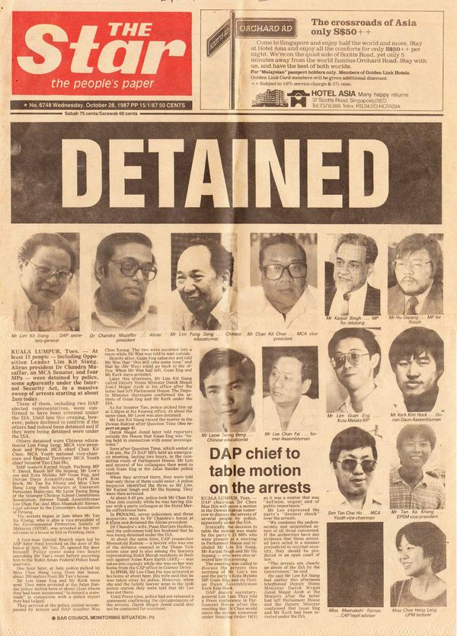
The 1980s and 1990s saw a new dimension in Malaysia’s political and socio-economic developments through privatization and the “Look East Policy”.
At the tail end of the 1980s, Mahathir promulgated the Malaysia Incorporated Policy
They are continuationa of Mahathir’s crusade for the improvement of the Malay’s economic position vis-à-vis other ethnic groups
Mahathir’s economic policies mostly benefit the upper-echelon Malays as opposed to the general Malay population
In addition to his populist approach, Mahathir was unafraid to use authoritarianism as a means of keeping his hold on power.
For instance, he was the one responsible for using the repressive Internal Security Act (ISA) to suppress critics and evade judicial review of his government's actions
The most notorious crackdown carried out by the Mahathir administration was called "Ops Lalang"
Mahathir launched Vision 2020 as part of the National Development Plan (NDP), which was his plan to make Malaysia a developed country by 2020 - the rise of right-wing supremacist ideas has led to a more intolerant and fractured society in 2020
Mahathir successfully utilized Islam: one could continue to cling tenaciously to one's moral and religious ideals without having to forfeit one's prospects in the economic sphere (Jeshurun, 1993, p. 206).

Slide 10
ISLAMIZING FOREIGN POLICY

Slide 11
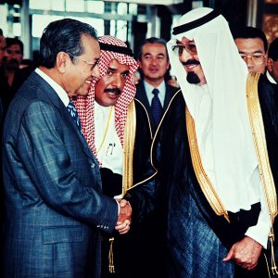
As Malaysia’s stature improved in the 1990s due to its economic development, Malaysia begun to take on a larger role in international affairs.
As part of Mahathir’s wider shift away from the West, Malaysia began to play a more active role as a leading Muslim nation
Mahathir’s authoritarian populism now has a streak of civilizational populism of an “us” against “the west”
He articulated concerns concerning the Islamic World.
The liberation of Palestine
The Soviet invasion of Afghanistan (helped Mujahideen)
Both Gulf Wars
The Bosnian War (enlisted personnel to Bosnia to serve under the United Nations Protective Force )
Mahathir talked openly on Islamic issues on the world stage post-9/11 especially on misunderstandings towards the religion, and the role of the West in perpetuating Islamophobia.
Mahathir's rhetoric of helping Muslim nations does not correspond with the resources that are at the disposal of the Malaysian government.
The only role that Islam played in Malaysia's foreign policy was a rhetorical one because those topics were intended to resonate with Malaysian Muslims.

Slide 12
Anti-Elite Populist and Muslim Democrat

Slide 13
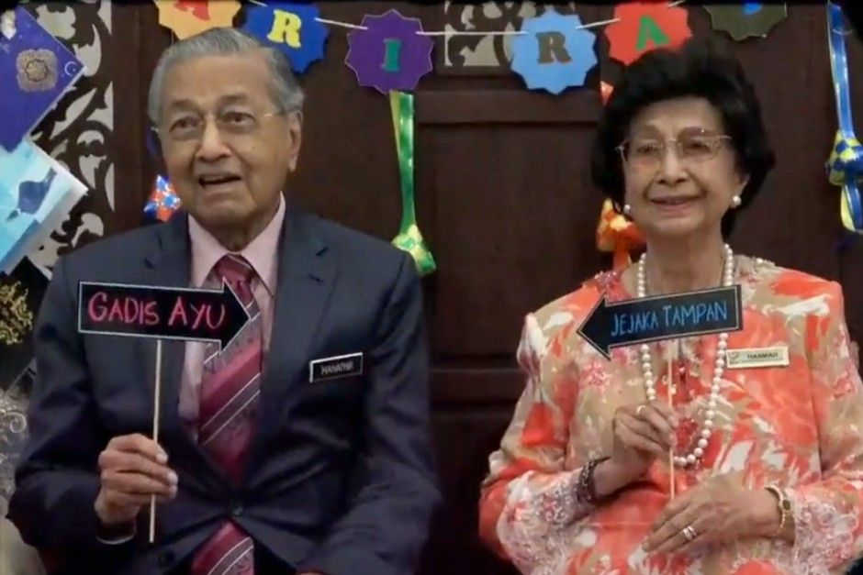
While Mahathir was in power for 22 years, he couldn’t represent anti-elite populism as he was part of the establishment
Under PH, Mahathir became an anti-elite populist who presented himself as humbler and more down-to-earth in comparison to Najib
At the height of the 1MDB scandal, Mahathir even joined forces with the opposition to attend the fourth rally organized by Bersih
After quitting UMNO in February 2016, he signed a so-called Citizens’ Declaration with his former foes such as Lim Kit Siang.
While this appears opportunistic, it is argued that Mahathir was using his populist appeal to supposedly represent the masses (hence the name ‘Citizens’ declaration)
As part of the Pakatan Harapan coalition, Mahathir stressed that an Islamic state is built upon values of justice, compassion and mercy as opposed to rote application of Islamic law
However, PAS and UMNO claimed that with Pakatan Harapan ruling the country, the special rights for Malays and Muslims are jeopardized
In response to this, Mahathir himself reverted from his Muslim democrat approach to his more tried-and-tested strategy of ethno-religious populism

Slide 14
1970s Education Policies | 1980s-90s Islamization Policies | 1980s-90s Economic Policies | 1990s-2000s Foreign Policies | 2018-2020 Muslim Democrat
Cabinet Committee Report on Review Implementation of Education Policies (Mahathir Report) | Islamic Banking & Finance (e.g., Bank Islam, Lembaga Urusan dan Tabung Haji, Takaful) | Privatisation | Pro-Palestine | ‘New Malaysia’ focuses on justice and rule of law
Islamic religious knowledge become examination subject | Education System (e.g., Islamic Teachers’ College, International Islamic University Malaysia) | Malaysia Inc. | Anti-Zionism
 | Legal System (e.g., elevating status of syariah courts and judges to be on par with civil judiciary) | Buy British Last | Supporting Afghan Mujahideen
 | Behavioural Policies (e.g., Inculcation of Islamic Values in Administration) | “Look East Policy” | Sending officers as part of UNPROFOR in Bosnia
 | Halal Food Certificate | Asian Values | KL Summit 2019
 | Department of Islamic Development of Malaysia (JAKIM) | Vision 2020
 | Institute of Islamic Understanding Malaysia (IKIM)

Slide 15
SUMMARY
As exemplified by the previous table, Islam has always been important in Mahathir’s policy formulation. Islam may not be at the centre of some policies over the decades, but it provided the justification and encouragement for policies such as the “Look East Policy” (the hardworking Muslim). But following the Reformasi movement and democratization in Malaysia in the 2000s, he needed to compete with other Malay leaders who either have stronger Islamic credentials (Abdullah) or closer relations with countries in the Middle East (Najib). While Mahathir tried to situate himself as a Muslim leader within this space, his main priority has always been and always will be to champion the Malays at home for the purpose of staying in power.

Slide 16
THANK YOU
Syaza Shukri
syazashukri@iium.edu.my

